Slide 1





Capitalizing on the $72.6 trillion opportunity:
A unified digital generational wealth management platform
Matthew Huehne
Abbey
Caller
Sameel
Deoji
Isabella
Fernando
Notes:
- Add names under the photos
positive, outcome, pun, metaphor

Slide 2
LINK SLIDE
Executive Summary
SITUATION
InvestCloud’s clients represent 40% of the $132 trillion in assets managed globally. The industry has an opportunity to capitalize on the great generational wealth transfer as $72.6 trillion is estimated to shift to heirs by 2045 in the U.S.
QUESTION
How can InvestCloud leverage AI and data intelligence to create a unified digital experience that seamlessly connects stakeholders, automates workflows, delivers hyper-personalized recommendations, and builds client trust.
STRATEGY
Unified digital experience for investors and customers across generational wealth transfer continuum. Our product – NextGen.
IMPACT
$64.3 million ARR projected in 2029
56.2%
ROI
฿27.04m
Net Profit
36.6%
Profit Margin

Slide 3
LINK SLIDE
Industry is expected to grow to $14.74 billion by 2032
WealthTech solutions market ($USD billions)
13.9% CAGR
2024 - 2032
Sources: Market Research Future (2025)
Notes:
CAGR rise driven by rise in alt. assets, and tech-driven intelligence demand

Slide 4
InvestCloud has a significant market opportunity with the great generational wealth transfer
LINK SLIDE

Slide 5

LINK SLIDE
North America’s wealth transfer will total $84.4 trillion by 2045
$72.6 trillion
Value of wealth transfer by 2045
Sources: Cerulli Associates, (2022)
Notes:
Stringent data regulation in EU
APAC survey: 70% people say data privacy is top concern
USA: no comprehensive policies
Sources: European Commission, (2025); InvestCloud (2025); McKinsey & Company (2023); U.S. Government Accountability Office (2022)
Cybersecurity expert says it’s worth $60

Slide 6
LINK SLIDE
North America will have largest wealth transfer by 2030
$10.61 trillion
Value of wealth transfer by 2030
Sources: Wealth-X (2021)
Notes:
Stringent data regulation in EU
APAC survey: 70% people say data privacy is top concern
USA: no comprehensive policies
Sources: European Commission, (2025); InvestCloud (2025); McKinsey & Company (2023); U.S. Government Accountability Office (2022)

Slide 7

LINK SLIDE
EU region will have the second-largest wealth transfer by 2030
$3.582 trillion
Value of wealth transfer by 2030
Sources: Wealth-X, (2021)
Notes:
Stringent data regulation in EU (GDPR)
APAC survey: 70% people say data privacy is top concern
USA: no comprehensive policies
Sources: European Commission, (2025); InvestCloud (2025); McKinsey & Company (2023); U.S. Government Accountability Office (2022)

Slide 8

LINK SLIDE
APAC will have the third-largest wealth transfer by 2030
$2.812 trillion
Value of wealth transfer by 2030
Sources: Wealth-X, (2021)
Notes:
Stringent data regulation in EU
Under-penetrated market compared to US and EU
APAC survey: 70% people say data privacy is top concern
USA: no comprehensive policies
Sources: European Commission, (2025); InvestCloud (2025); McKinsey & Company (2023); U.S. Government Accountability Office (2022)
Asia-Pacific (APAC) region will have the third-largest wealth transfer by 2030

Slide 9






LINK SLIDE
The total global wealth transfer by 2030 will be $18.346t
Ultra-high net worth individuals will transfer $12.2 trillion (66.52%)
92% of transfers will be from North America, EU and APAC
About 680,000 people with at least $5 million will be transferring wealth by 2030
Nearly half of wealthy families don’t have the most basic elements of estate planning in place
67% of millennials
want hyper-personalized recommendations
Robo-advisors expected to
manage $2.5 trillion by 2025 –
demand for low cost services
Sources: Wealth-X (2021); Yahoo Finance (2024); Deloitte (2025).
Notes:
As revealed in Orion’s second annual Wealthtech Survey, 57% of advisors are currently focused on generational wealth transfer as a growth opportunity, with another 36% expected to do so over the next three years
Bank Administration Institute says it will “end up as the greatest transfer of wealth in history.”
https://finance.yahoo.com/news/great-wealth-transfer-baby-boomers-110047810.html

Slide 10
InvestCloud can capitalize on the market opportunity by expanding their product offerings
LINK SLIDE
Notes:
- Add names under the photos
positive, outcome, pun, metaphor
- What's the metaphor
- Dress is distracting
Make real consulting brand

Slide 12

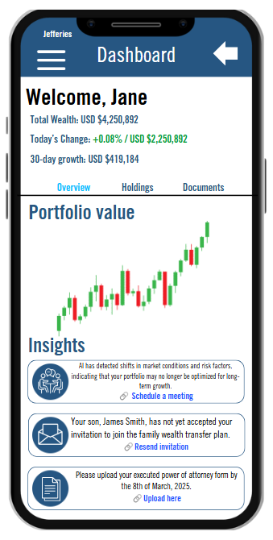

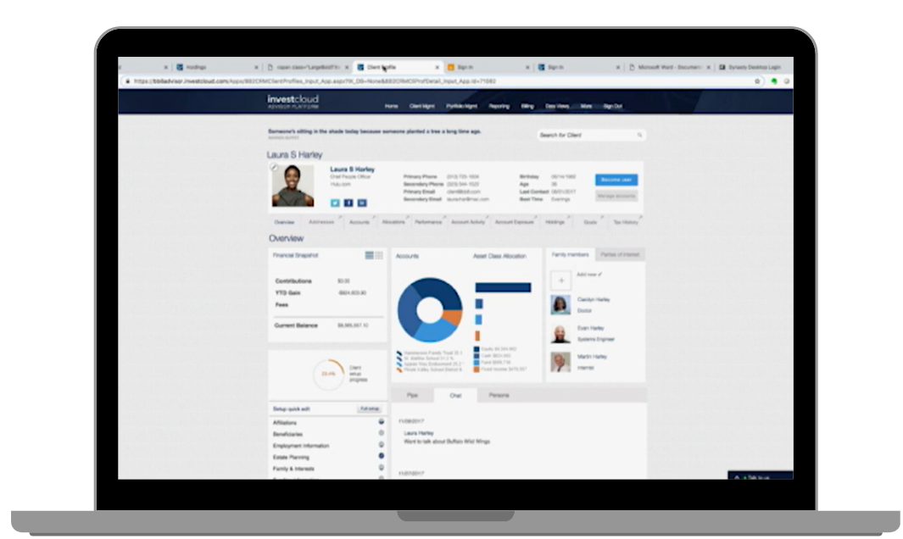
LINK SLIDE
Transform generational wealth transfer with InvestCloud’s seamless, multi-generational solution, NextGen
Why It’s a Selling Point: The app provides a shared family dashboard that offers a holistic view of generational wealth, including portfolios, risk profiles, and investment strategies. This unified platform connects advisors (desktop) and families (mobile) in real time, ensuring seamless collaboration and transparency.
Value: Advisors can manage multi-generational wealth efficiently, while families gain real-time insights into their financial health, fostering trust and engagement across generations.
Unified Digital Experience for Multi-Generational Wealth Management with Client and Advisor User Interface
Why It’s a Selling Point: The app automates repetitive tasks such as regulatory reporting, document management, and compliance checks, reducing manual effort and minimizing errors. It also provides reminders for critical actions (e.g., uploading legal documents or accepting invitations to wealth transfer plans).
Value: Advisors save time and ensure compliance with global regulations, while families experience a smoother, more efficient wealth transfer process, reducing stress and delays.
AI-Driven Hyper-Personalization and Predictive Analytics
Automated Workflows and Compliance Tools
Why It’s a Selling Point: The app automates repetitive tasks such as regulatory reporting, document management, and compliance checks, reducing manual effort and minimizing errors. It also provides reminders for critical actions (e.g., uploading legal documents or accepting invitations to wealth transfer plans).
Value: Advisors save time and ensure compliance with global regulations, while families experience a smoother, more efficient wealth transfer process, reducing stress and delays.

Slide 13
LINK SLIDE
NextGen provides a suite of tools for all stages of the generational wealth transfer lifecycle
Shared Family Dashboard
AI-Based Education
Inviting the next generation
Building financial literacy
Before
Scenario Planning
Will and Trust Management
Family Communication Tools
Planning for the next generation
ESG Insights
Investment Portfolio Management
Life Planning Tools
Understanding financial interests
After
During
Ongoing management
Navigating the
transfer
Behavioural Insights
Budgeting and Expense Tracking
Scheduling Meetings
Tax Optimization Tools
Legal Document Management
Process Tracking

Slide 14


LINK SLIDE
Banks must adapt now to retain wealth across generations as younger heirs move their assets elsewhere
87% of heirs plan to move their inheritance away from their parents’ banks
% of respondents who would use a financial advisor
While 75% of younger investors prefer digital tools for managing their wealth, only 30% feel that their parents’ financial advisors meet their digital expectations
Sources: Global Finance (2024); Wealth and Finance Digital (2024).

Slide 15




LINK SLIDE
Engaging inheritors early through the Family Dashboard and advisor conversations will create lasting relationships
SUSTAIN
Multi-Generational Wealth Overview
MANAGE
Real-Time Wealth Transfer Status
EMPOWER
AI-Driven Recommendations for Next Steps
UNDERSTAND
Behavioural Analytics Driven by Financial Data

Slide 16

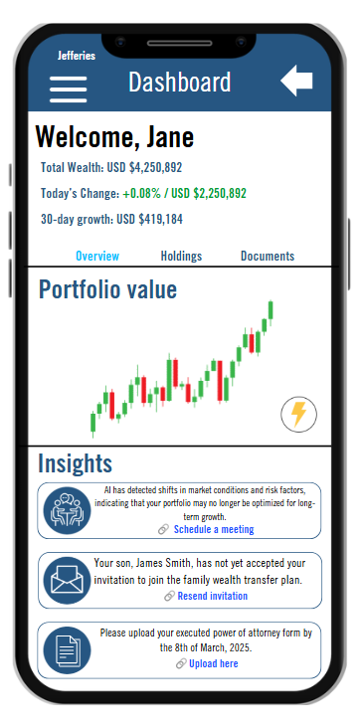
LINK SLIDE
Empowering Investors and Inheritors with AI-Driven Workflows, Hyper-Personalization, and Actionable Insights
Personalized, at-a-glance view of the user’s financial status
Transform the Portfolio Value section into a dynamic, Gen AI-powered tool that provides
easy-to-understand personalized reports, summaries and visualizations
AI analyzes market conditions, risk factors, and portfolio performance to provide actionable insights
Real time alerts for important actions, milestones, or changes in portfolio performance
AI ensures compliance by automating reporting and documentation

Slide 17

LINK SLIDE
Inheritors lack financial literacy causing a massive loss of wealth
Younger age groups report different financial literacy needs from older ones
Generation Z cited understanding how to do taxes and how to reduce debt
Millennials report improving credit scores and saving for retirement
Generation X are focused on saving for retirement. Boomers are far more likely to have these skills already
70% of wealthy families lose their wealth by the 2nd generation
90% lose their wealth by the 3rd generation
Parents and their wealth managers have an opportunity to educate inheritors now about these issues before handing over significant wealth
Sources: Global Finance (2024); Wealth and Finance Digital (2024).
Notes:
Through a combination of asset dispersal, capital losses and inheritance tax

Slide 18



LINK SLIDE
Empowering financial knowledge for the next generation
Stay informed with curated articles on wealth management, tax strategies, and financial planning
AI-generated quizzes to test and reinforce your knowledge
Encourage continuous learning and commitment to financial education
Sources: Global Finance (2024); Wealth and Finance Digital (2024).

Slide 19
A structured go-to-market approach can enable sales
LINK SLIDE
Notes:
- Add names under the photos
positive, outcome, pun, metaphor
- What's the metaphor
- Dress is distracting
Make real consulting brand

Slide 20

LINK SLIDE
A unified platform is a core purchasing criteria for the customer
Tax efficiency and optimization insights
Progress tracking and transfer management
Personalized financial guidance
Generational education
Enhanced collaboration and dashboarding
Sources: Adams & Brown (2025); SS&C Technologies; Cavanaugh; Khan (2024).
Notes:
Competitor inclusions and research included in customer needs

Slide 21




LINK SLIDE
Key competitors are meeting core customer needs
Wealth Transfer Continuum
Multi-generational connectivity
Sources: Lynn (2004).
Notes:
BlackRock – Strong analytics and risk management but limited holistic generational visuals, good advisor-client interaction but less targeted at multi-generational experiences
Orion – Comprehensive reporting and planning tools but less targeted at
Black Diamond –

Slide 22
LINK SLIDE
A structured versioning approach can enable sales
MVP
V1
V2
V3
NOT a sellable product
Signal to the market
Validating product features
Entry point and MSP
Feature parity with competitors
Competitive consumer option
Outperform competitors
Industry winning inclusions
Sources: Shapiro & Varian (1998).
56.2%
ROI
฿27.04m
Net Profit
36.6%
Profit Margin

Slide 23

LINK SLIDE
Four key marketing channels to boost product awareness
Channel | Activity | Resource | Why
Email marketing | Distribute emails to existing clients advising of tool | Outlook/Email system In-house FTE | 14% of marketers say that email campaigns provide the strongest ROI
Demos | Live & on-demand walkthroughs of the solution | Support FTE Digital meeting tools | Online conversion rates improve by 7.9x when users can engage with a demo
Thought Leadership | Sharing industry learnings as articles with customers | In-house FTE Social media / email access | 73% of B2B decision-makers trust thought leadership as marketing tool
SEO | Optimise search engine results to suggest InvestCloud | SEO analytics | 68% of online experiences start with a search engine
Sources: Shopify; Ong; Dey; Edelman (2024).
Notes:
14% of email marketers
independent advisors are gaining share and are easier to sell solutions into than the largest banks and warehouses, which are known for long sales cycles as well as hesitancy to work with more innovative solutions. (Source: McKinsey)

Slide 24
Financial Analysis: Revenue, Profitability & Scalability
LINK SLIDE
Notes:
- Add names under the photos
positive, outcome, pun, metaphor
- What's the metaphor
- Dress is distracting
Make real consulting brand

Slide 25
LINK SLIDE
$64.3m Annual Recurring Revenue Projected in 2029
Total Subscription Revenue ($ Millions)
Operating Cash Flow ($ Millions)
Breakeven
Annual Recurring Revenue (ARR)
Grows from $714K in 2025 to $64.3M by 2029, supported by enterprise adoption.
Breakeven Achieved in Year 2 (2026)
The business model is self-sustaining after just two years.
Operating Cash Flow
Reaches $52.9M in 2029, showing strong long-term profitability.
This expansion represents a low-risk, high-reward opportunity within InvestCloud’s existing ecosystem
56.2%
ROI
฿27.04m
Net Profit
36.6%
Profit Margin
Notes:
14% of email marketers

Slide 26
LINK SLIDE
Adoption by medium firms assumed to lead platform generation
Adoption Rate
Revenue Contribution by Plan (Small, Medium, Enterprise)
Plan | Adoption Rate | Reasoning
Small Plan | 15% of total advisors | For entry-level users who need core tools at lower costs.
Medium Plan | 75% of total advisors | The most attractive tier with AI, automation, and CRM integrations.
Enterprise Plan | 10% of total advisors | Large firms, private banks, and family offices needing full compliance and automation.
Adoption Rate Assumptions
Most advisors pick mid-tier plans because they offer the best value and features, following SaaS trends of 65-80% mid-tier adoption.
Fewer choose entry-level plans since they lack AI tools, and many either upgrade or leave within a year.
Large firms take longer to adopt premium plans, but they bring in high revenue per user over time.
Notes:
Cybersecurity expert says it’s worth $60

Slide 27
LINK SLIDE
Scalable SaaS pricing keeps costs at pace with revenue
Cost Breakdown (Fixed vs. Variable Costs Over Time)
Key Points
One-time platform development investment ($500K in 2025) covers AI model creation, infrastructure setup, and UI/UX development.Fixed costs (marketing, compliance, cloud infrastructure) remain steady at ~$400K/year, ensuring predictable expenses.Variable costs, primarily customer support, scale proportionally with advisor adoption.Cloud and AI costs remain consistent (~$120K per year) due to long-term enterprise cloud pricing agreements.
One-time platform development investment
Covers AI model creation, infrastructure setup, and UI/UX development.
Fixed costs
Marketing, Compliance & Legal, Sales Marketing, AI maintenance
Variable costs
Primarily cloud, AI and customer support costs scale proportionally with advisor adoption.
Key Assumptions
✔ Fixed costs (compliance, cloud, marketing) remain stable over 5 years.
✔ Customer support scales directly with advisor adoption (est. $50/month per advisor).
✔ SaaS cost structure ensures revenue growth outpaces expenses, improving margins over time.
Fixed costs
These costs stay steady as they don’t scale with users, benefiting from fixed pricing and enterprise efficiencies.
0.48
Cost-to-Revenue Ratio
Customer support and cloud costs scales
Scales directly with advisor adoption (est. $50/month per advisor).
2025:
Very high (~100%)
2026:
Drops to ~30%
2027-2029:
Stabilizes at ~20%
SaaS cost structure
Ensures revenue growth outpaces expenses, improving margins over time.

Slide 28



LINK SLIDE
LINK SLIDE
NextGen has high ROI estimated
Indicate Strong Returns, Low Risk, and a Scalable Growth Opportunity
Why does this investment stand out?
Revenue & Cash Flow Growth ($ Millions)
Breakeven In 2 Years
Revenue quickly exceeds costs.
$52.9M cash flow by 2029
High-margin, low-risk scalability.
Predictable subscription revenue
High-margin, low-risk scalability.
Minimal competitive threats
InvestCloud leverages its existing client base.
Steady cost structure allows profits to scale rapidly.
InvestCloud’s existing infrastructure enables cost-effective scaling.
Recurring revenue model ensures predictable, long-term returns
Notes:
Strong Returns, Low Risk, and a Scalable Growth Opportunity

Slide 29
LINK SLIDE
Executive Summary
SITUATION
InvestCloud’s clients represent 40% of the $132 trillion in assets managed globally. The industry has an opportunity to capitalize on the great generational wealth transfer as $72.6 trillion is estimated to shift to heirs by 2045 in the U.S.
QUESTION
How can InvestCloud leverage AI and data intelligence to create a unified digital experience that seamlessly connects stakeholders, automates workflows, delivers hyper-personalized recommendations, and builds client trust.
STRATEGY
Unified digital experience for investors and customers across generational wealth transfer continuum. Our product – NextGen.
IMPACT
64.3 million ARR projected in 2029

Slide 30
LINK SLIDE
Questions
What does InvestCloud do?
What growth is expected in the industry?
How much wealth is expected to be transferred across different regions?
How are Gen X and Millennial behaviors changing?
What solutions were considered?
What is the solution?
What is the customer journey map?
How are young inheritors managing their wealth?
What are the components of the dashboard?
What is the go-to-market approach?
What are competitors doing?
What are the product versions?
What is the marketing strategy?
What is the total subscription revenue and operating cash flow
What is the adoption rate?
What is the cost break down and scalability?
What is the ROI and investment justification?
What other solutions did we consider?
Notes:
Cybersecurity expert says it’s worth $60

Slide 31
Subscription Plan Pricing Model
Plan | Price (per advisor/month) | Target Users | Key Features
Small | $150 | Independent advisors, small firms | Core estate planning tools, document storage, basic AI insights
Medium | $300 | Mid-sized RIAs, private wealth advisors | AI-driven predictive modelling, CRM integration, estate tax calculator
Enterprise | $500 | Large private banks, family offices | Full AI-powered estate planning, legal automation, custom API & compliance
Why This Pricing Model?
Tiered Pricing Maximizes Revenue & Market Reach
Advisors & small firms can afford entry-level access via Basic Plan ($150/month).
Mid-sized firms needing AI-driven tools can upgrade to Medium ($300/month).
Enterprise clients (banks, RIAs, family offices) pay premium pricing ($500/month) for full-service capabilities.
Competitive Benchmarking Supports Price Points
Industry pricing models (eMoney Advisor, Orion, RightCapital) range from $150–$500 per month per advisor.
InvestCloud’s strong market position justifies premium pricing for AI-driven solutions.
Aligns Pricing with Cost Drivers
Basic plan covers fixed cloud & compliance costs.
Pro plan funds AI computing, integrations, and advanced estate modelling.
Enterprise plan absorbs support, security, and API integration costs.
Encourages Upgrading & High Retention
Firms start at Basic and upgrade to Pro/Enterprise as estate planning needs grow.
High-value features (AI predictions, compliance automation) create stickiness & long-term retention.
Notes:
Cybersecurity expert says it’s worth $60

Slide 32
LINK SLIDE
LINK SLIDE
WealthConnect Solution (Wealth Transfer Hub) and App Template Start
Platform Development Cost Breakdown
Cost Component | Estimated Cost ($) | Justification
AI Model Development (Wealth Transfer Solution) | 150000 | Develop AI-powered inheritance visualisation and predictive wealth transfer insights.
Cloud Infrastructure Setup | 100000 | Set up scalable cloud storage and AI processing to support real-time analytics.
Security & Compliance | 50000 | Ensure compliance with financial regulations (SEC, GDPR) and protect sensitive wealth data.
UI/UX Design & Development (Wealth Transfer Solution) | 75000 | Create an intuitive advisor interface for managing estate planning and wealth transitions.
Backend Development (Wealth Transfer Solution) | 75000 | Build backend logic to handle multi-generational wealth visualisation and transition workflows.
End-User App Template UI/UX | 50000 | Design an engaging front-end experience for investors accessing estate planning tools.
End-User App Backend Development | 75000 | Develop secure and scalable backend infrastructure for the end-user wealth app.
Third-Party API Integrations | 25000 | Integrate with CRMs, legal/tax software, and estate planning tools for seamless workflow.
Initial Marketing & Launch Costs | 25000 | Launch targeted campaigns for private banks, RIAs, and wealth managers to drive adoption.
Notes:
Cybersecurity expert says it’s worth $60

Slide 33
LINK SLIDE
WealthConnect Solution Yearly Costs
Yearly Cost Breakdown
Year | Platform Development | Compliance & Legal | Sales & Marketing | Cloud Infrastructure | AI Maintenance | Customer Support | Total Costs
2025 | 625000 | 100000 | 200000 | 120000 | 60000 | 120000 | 1100000
2026 | 0 | 100000 | 200000 | 120000 | 60000 | 1800000 | 2280000
2027 | 0 | 100000 | 200000 | 120000 | 60000 | 4500000 | 4980000
2028 | 0 | 100000 | 200000 | 120000 | 60000 | 7200000 | 7680000
2029 | 0 | 100000 | 200000 | 120000 | 60000 | 10800000 | 11280000
Why These Costs Stay Fixed
Cost Category | Fixed at | Why It Doesn’t Scale with Advisors
Compliance & Legal | $100K/year | Regulatory oversight costs are constant, regardless of user count.
Sales & Marketing | $200K/year | B2B-focused sales, targeting firms, not individual advisors.
Cloud Infrastructure | $120K/year | Enterprise cloud contracts provide fixed costs with incremental scalability.
Could These Costs Ever Change?
If InvestCloud expands into new regulatory markets, compliance costs may increase
If InvestCloud shifts to more aggressive direct-to-advisor marketing, sales costs could rise.
If cloud adoption scales beyond expected usage, infrastructure costs may need adjustment.
Notes:
Cybersecurity expert says it’s worth $60

Slide 34
LINK SLIDE
Why haven’t the projections been discounted?
Market Adoption Uncertainty vs. Conservative Assumptions:
Instead of discounting, we already used a conservative adoption S-curve (not assuming instant 100% market penetration).
Our projections account for enterprise adoption timelines, limiting overstatement of revenue.
InvestCloud's Established Market Position:
InvestCloud already has 550+ direct clients and a trusted reputation.
The risk of failure in adoption is lower than that of a startup.
SaaS Business Model – Recurring Revenue Matters More Than Discounting:
SaaS revenue growth and ARR retention are more critical for valuation than heavy discounting.
Unlike long-term capital-intensive projects, SaaS relies on predictable scaling and customer retention.
Sources: Caminiti, (2024); Kalkman et al., (2019); McKinsey & Company, (2024); World Economic Forum, (2023).
Notes:
Cybersecurity expert says it’s worth $60

Slide 35
LINK SLIDE
Adoption rate assumptions
Adoption Rate Assumptions
Adoption Rate Assumptions
Plan | Adoption Rate | Reasoning
Small Plan | 15% of total advisors | For entry-level users who need core tools at lower costs.
Medium Plan | 75% of total advisors | The most attractive tier with AI, automation, and CRM integrations.
Enterprise Plan | 10% of total advisors | Large firms, private banks, and family offices needing full compliance and automation.
We assumed that most advisors would opt for the Medium Plan because:
Mid-tier plans generally capture the majority (60-80%) of SaaS subscribers.
Medium offers the best balance of value vs. cost.
AI-driven tools and CRM integration make this plan highly attractive for RIAs and private advisors.
Why This Distribution Makes Sense
✔ Matches real-world SaaS adoption trends, where most users opt for mid-tier plans.
✔ Basic plan users stay limited (15%) since firms seeking long-term estate planning solutions prefer AI-powered tools.
✔ Enterprise users (10%) represent private banks and family offices, who demand high customization, legal compliance, and security.
✔ Revenue scales in alignment with enterprise SaaS pricing models, ensuring profitability and user retention.
Sources: Caminiti, (2024); Kalkman et al., (2019); McKinsey & Company, (2024); World Economic Forum, (2023).
Notes:
Cybersecurity expert says it’s worth $60

Slide 36
LINK SLIDE
Why isn’t churn rate considered?
This case focuses on adoption, revenue growth, and feasibility, meaning churn impact is lower in the first 5 years.
InvestCloud’s enterprise clientele (private banks, RIAs) have long-term contracts, leading to low churn (<10%).
Revenue projections already assume a realistic S-Curve adoption, which factors in gradual user drop-off naturally.
Not strictly necessary for this case, as the focus is on revenue growth.
If required, assume ~10% churn per year for realism.
Churn matters more post-2029, when retention impacts long-term revenue.
Notes:
Cybersecurity expert says it’s worth $60

Slide 37
LINK SLIDE
Breakeven analysis
Year | ARR (Revenue) ($M) | Total Costs ($M) | Operating Cash Flow ($M) | Cumulative Profit/Loss ($M)
2025 | $0.71M | $1.10M | -$0.39M | -$0.39M (Loss)
2026 | $10.71M | $2.28M | $8.43M | $8.04M (Break-even achieved)
2027 | $26.78M | $4.98M | $21.80M | $29.84M (Scaling profit)
2028 | $42.84M | $7.68M | $35.16M | $65.00M
2029 | $64.26M | $11.28M | $52.98M | $117.98M (Highly profitable)
Notes:
Cybersecurity expert says it’s worth $60

Slide 38
LINK SLIDE
What classifies a HNW and UHNW person
High net worth (VHNW) individuals: those with a net worth of $5m to $30m.
Ultra high net worth (UHNW) individuals: those with a net worth of $30m+, also referred to as the ultra wealthy.
Sources: Caminiti, (2024); Kalkman et al., (2019); McKinsey & Company, (2024); World Economic Forum, (2023).
Notes:
Cybersecurity expert says it’s worth $60

Slide 39




LINK SLIDE
InvestCloud’s values
Human-led
Future-driven
Connection
Continuous improvement
Excellence
Sources: Caminiti, (2024); Kalkman et al., (2019); McKinsey & Company, (2024); World Economic Forum, (2023).
Notes:
Cybersecurity expert says it’s worth $60

Slide 40
LINK SLIDE
We considered a range of solutions for InvestCloud
Ref | Solution | Deliberation
1 | Client-facing robo-advisor available as an additional product to be white-labelled | A similar solution exists in the InvestCloud ecosystem
2 | Expanding partnerships with Regional Banks | Regional banks compete with RIAs and wirehouses, where we were asked to tailor our solution to all three
3 | Localised risk and compliance software, applicable globally | InvestCloud wanted to see significant ROI and value evident within 5 years, this tool did not appear to have significant ROI upon our review
4 | End-user applications for financial management | This solution exists in the InvestCloud ecosystem
6 | Unifying the Generational Wealth Transfer experience to capitalise on this market opportunity with intuitive UI and AI-driven insights

