Slide 1


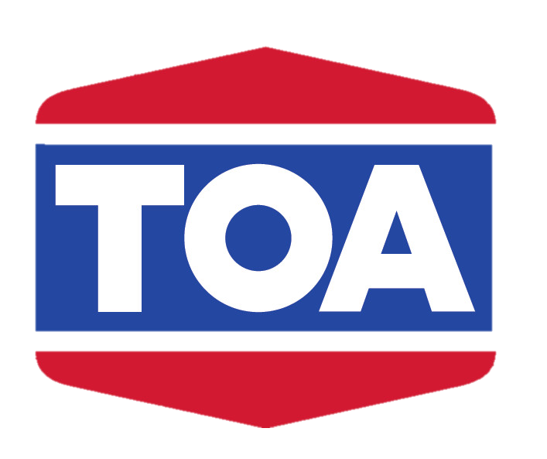
Positioning TOA as Vietnam’s Eco-Innovative Paint Brand of Choice
Cameron Mah, Kate Bellars, Abbey Caller, Matthew Huehne

Slide 2

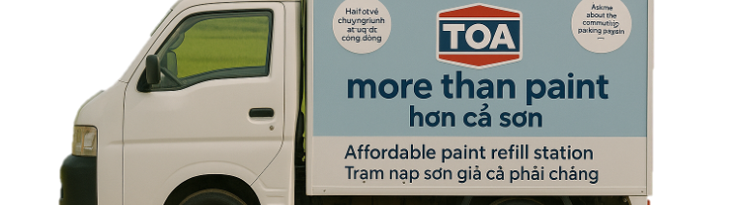

Environmental only accounts for 4% of sales
Executive Summary
Eco-Conscious Shift
Underserved Markets
Digital Loyalty Gaps
Vietnamese homeowners are prioritising eco-friendly, non-toxic paints
TOA lacks presence in rural markets where local brands win with affordable paint
Painters, contractors, and retailers lack long-term engagement tools across all segments.
Insights
The economy segment makes up 32.7% of the market, but TOA holds just 3.2% share.
Inconsistent loyalty among medium-segment distributors
Low visibility in marquee real estate projects limits TOA’s premium presence.
Challenges
SHORTEN TEXT IN TEXTBOXES
- DOES “TOA” need to be in text
What strategic initiatives can TOA implement across the premium, medium, and economy segments to expand its market presence and establish a strong, sustainable position in Vietnam’s decorative paint market?
Question
A 3-Part Circular Paint Ecosystem to Drive Reach, Retention, and Responsibility
Strategy
Paint Pail Return Program supports ESG value and encourages product reuse
Mobile Refill Trucks increase rural access and expand economy market share
TOA Hub Platform builds long-term loyalty, tracks projects, and unites all users
THB 449.9m
Net Present Value
(NPV)
THB 34.1M
Operating Cash
Flow in 2028
3 Year
Payback period
achieved by Year 3
Impact
NPV
Operating cash flow 2028
Breakeven in 3 years

Slide 3
TOA Can Be a Platform for Circular Innovation, Community Connection, and Market Leadership in Vietnam.

Slide 4








TOA has the foundation but needs relevance visibility and trust to lead
Rural Market Access & Distribution Challenges
Digital Engagement & Loyalty Program Opportunities
Eco-Conscious Consumer Behaviour & Green Building Momentum
Market Growth & Strategic Positioning
Sources: Mckinsey (2024), Vietnam Ministry of Natural Resources & Environment (2025)

Slide 5
TOA has the foundation but needs relevance visibility and trust to lead
Rural Market Access & Distribution Gaps
65.6% of Vietnam’s population lives in rural areas, representing a large untapped base
46% of rural households earn under 10 million VND per month (approximately 13,500 THB), placing them in the economy segment
Local paint brands are more accessible in these areas due to stronger distribution
Rural Market Access & Distribution Challenges
Digital Engagement & Loyalty Program Opportunities
Eco-Conscious Consumer Behaviour & Green Building Momentum
Market Growth & Strategic Positioning
Sources: Mckinsey (2024), Vietnam Ministry of Natural Resources & Environment (2025)

Slide 6
TOA has the foundation but needs relevance visibility and trust to lead
Digital Engagement and Loyalty Gaps
Vietnam has high internet and mobile usage across all income levels
Companies with digital loyalty programs in Vietnam have improved customer retention and trust
Painters and small retailers lack long-term, tech-enabled loyalty tools
Rural Market Access & Distribution Challenges
Digital Engagement & Loyalty Program Opportunities
Eco-Conscious Consumer Behaviour & Green Building Momentum
Market Growth & Strategic Positioning
Sources: Mckinsey (2024), Vietnam Ministry of Natural Resources & Environment (2025)

Slide 7
TOA has the foundation but needs relevance visibility and trust to lead
Eco-Conscious Consumer Shift
TOA holds 35% of the premium segment and is viewed as high quality, with room to grow through sustainability
SEA consumers expect sustainability across the entire supply chain, from manufacturing to packaging
Vietnam’s Circular Economy Plan promotes closed-loop production and less waste in paint and related sectors
Rural Market Access & Distribution Challenges
Digital Engagement & Loyalty Program Opportunities
Eco-Conscious Consumer Behaviour & Green Building Momentum
Market Growth & Strategic Positioning
Sources: Mckinsey (2024), Vietnam Ministry of Natural Resources & Environment (2025)

Slide 8
TOA has the foundation but needs relevance visibility and trust to lead
Market Growth & Strategic Timing
The decorative paint market in Vietnam is experiencing robust growth, driven by urbanisation and increased construction activities.
TOA's focus on research, eco-friendly products, and technological advancements aligns with market demands and positions the company for sustained growth.
Rural Market Access & Distribution Challenges
Digital Engagement & Loyalty Program Opportunities
Eco-Conscious Consumer Behaviour & Green Building Momentum
Market Growth & Strategic Positioning
Sources: Mckinsey (2024), Vietnam Ministry of Natural Resources & Environment (2025)

Slide 9


Aspirational 3-year goal based on the current market landscape
Toa Vietnam can be more than paint it can be community and care
TOA’s Circular Ecosystem Strategy Is Built to Scale and Lead
1
1
Strategic Question
Drives ESG and customer retention
What initiatives will help TOA expand its market presence and lead sustainably across all price segments in Vietnam?
Aspirational 3-Year Goal
Establish TOA among Vietnam’s top 4 decorative paint brands within 3 years by scaling a circular ecosystem that expands rural reach, strengthens digital loyalty, and leads on sustainability.
2
Expands rural access and market share
Our Solution
A circular ecosystem strategy built on pail returns, mobile refills, and digital engagement to grow market share and lead with ESG.
3
Unifies loyalty and digital engagement

Slide 10
Toa Vietnam can be more than paint it can be community and care
TOA’s Circular Ecosystem Strategy Is Built to Scale and Lead
1
1
Strategic Question
Drives ESG and customer retention
What initiatives will help TOA expand its market presence and lead sustainably across all price segments in Vietnam?
2
Expands rural access and market share
Our Solution
A ‘More than Paint’ branded circular ecosystem strategy built on pail returns, mobile refills, and digital engagement to grow market share and lead with ESG.
3
Unifies loyalty and digital engagement

Slide 11
TOA Vietnam can establish itself as ‘More than Paint’ by drawing from global case studies in sustainable packaging

Slide 12
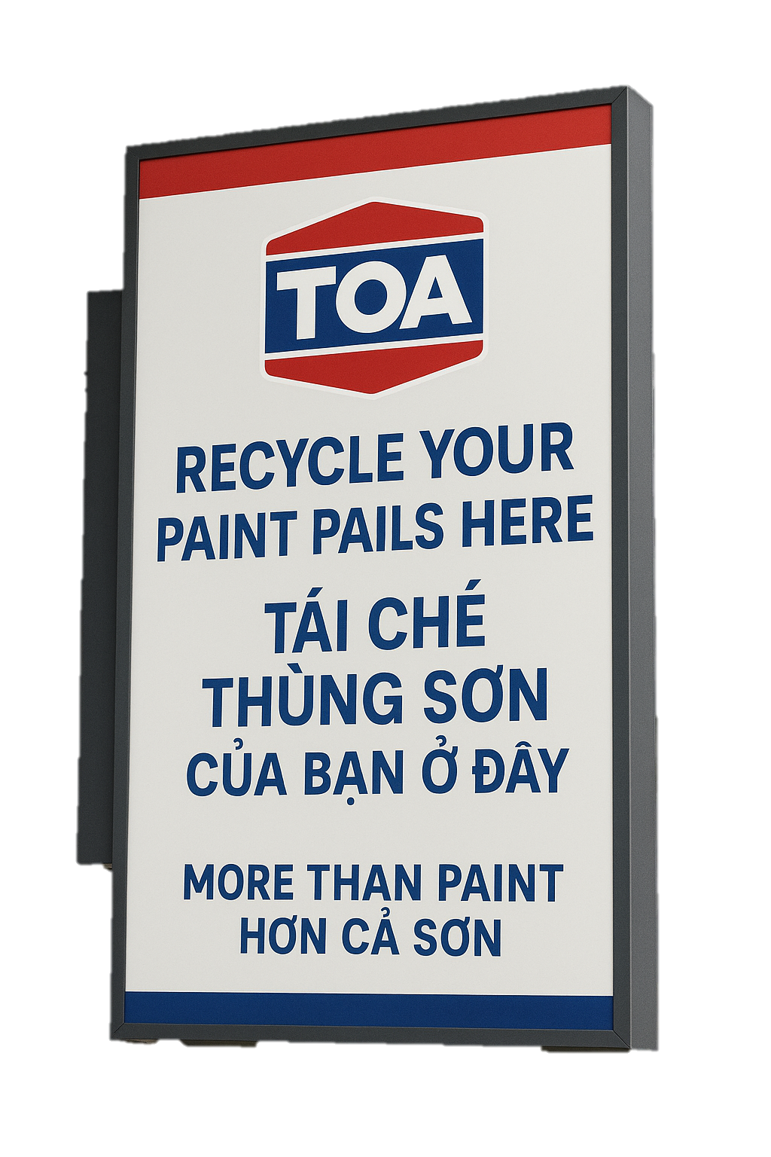

TOA Vietnam can deliver value in ‘More Than Paint’ by recycling paint pails and participating in community repaint projects
Global case study: Nippon Paint subsidiary success in Australia, saving approx. 345 million Viet Dong at each construction site in waste costs
Customers recycle paint pails for a partial rebate
Recycled pails used for future packaging requirements
Reducing packaging manufacturing costs
Increased segment infiltration
Environmentally- friendly production
Pail recycling points in distributor / retail stores
Reduced price points as a result of partial rebate scheme
Opportunity to contribute to community repaint projects
Sources: DuluxGroup 2024

Slide 13




This solution provides a recycling model that rewards customers and reduces plastic waste
Partial rebates for purchase price can encourage larger or more frequent purchases
National action plan to promote sustainable production, consumption, and reduced waste
Net zero targets, and vision to provide environmentally friendly products that cater to customers’ needs
LOTUS green rating system requires sustainable and recyclable construction materials
Partial rebates for purchase price can encourage larger or more frequent purchases
76% of Vietnamese consumers prefer locally-branded products, and 62% of Vietnamese consumers’ purchasing behaviour is influenced by a businesses commitments to communities
Sources: Nielsen (2022)

Slide 14
This solution provides a recycling model that rewards customers and reduces plastic waste
Paint sold in store / contract
Paint collected
Pails returned to store / retrieved
Pails sent to DC
Plastic sent to granulator
Manufactured into pails
Pail packaging returns to DC
Product added to packaging
Potential for grants, for reducing waste / pollution in consumer-packaged goods
Allows for reduced price points and enhanced energy-ratings in tendering for large development projects
Sources: …

Slide 15
TOA is well-positioned to adopt new innovations to address the large economy market in Vietnam

Slide 16
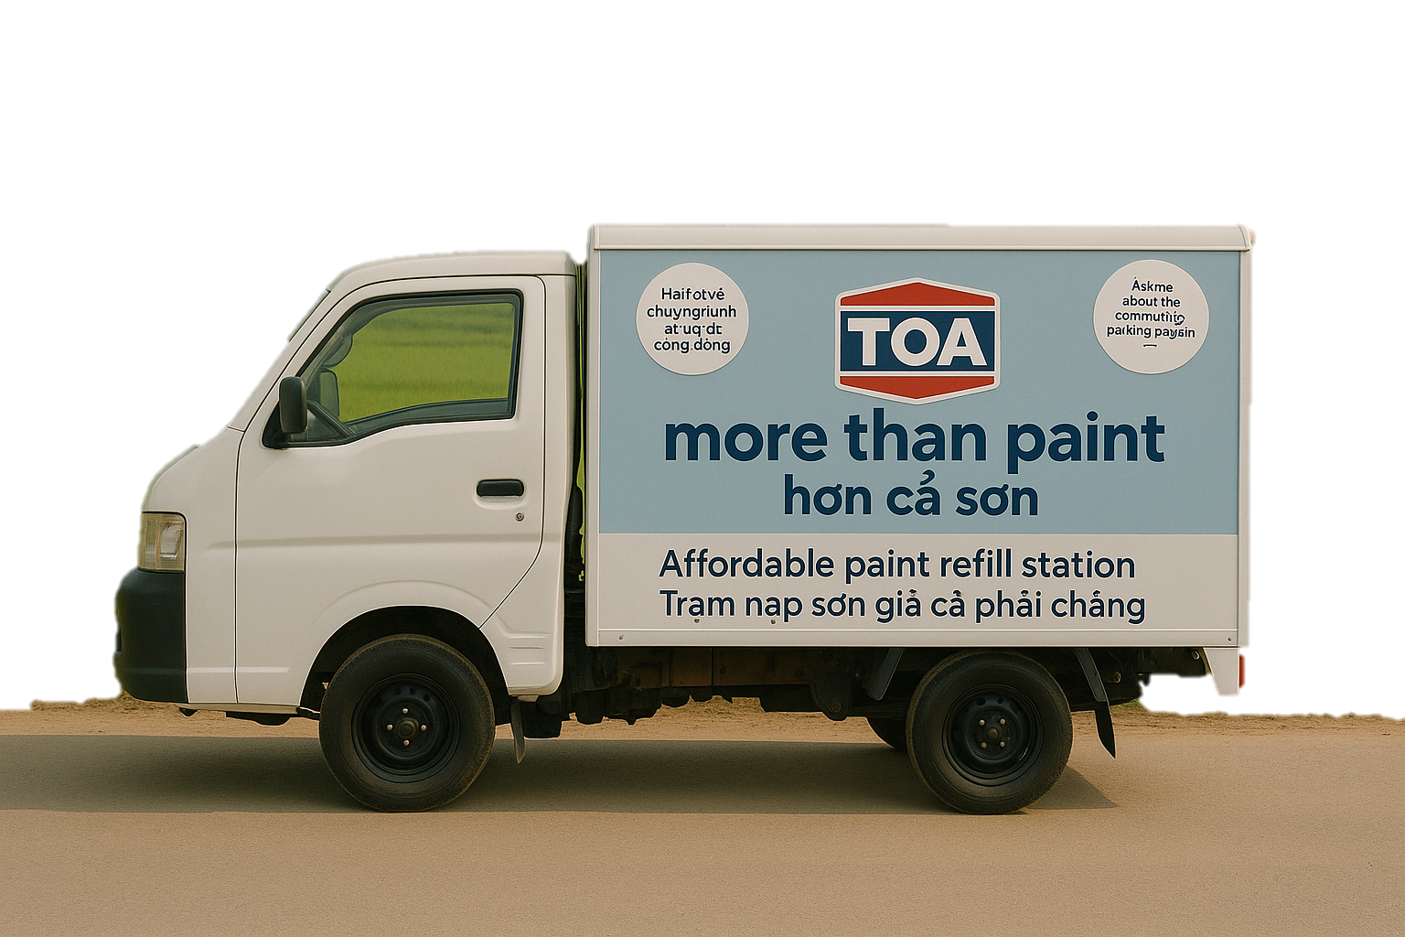

Mobile paint refilling stations can be deployed rurally to capture a significant portion of the economy market
The mobile paint refilling station can be used as a form of ’Outside Advertising’, offering a low-cost, highly effective strategy
Mobile van reaches rural areas on a weekly schedule
Reduces packaging cost, (approx. 15-20%) enabling reduced price point for refilled paints without sacrificing margin, serving economy customers
Users purchase a reusable pail and recycle use of the pail by refilling
Refill station provides cleaning and standard paints
Sources: Global Growth Insights 2024; Seen 2024

Slide 17
Mobile paint refilling stations address a need for brand awareness and affordability
3.2%
Economy segment is highly price-driven and dominated by local brands offering low-cost options
TOA’s current market share of the economy segment in Thailand
32.7%
65.6% of Vietnam’s population lives in rural areas
Of Vietnamese decorative coatings industry is in the economy sector
46% of rural households earn under 10 million VND per month (approximately 13,500 THB)
Stronger local brand presence in rural areas
Sources: …
Sources: CIBCC Booklet 2025; Statista 2024

Slide 18
Mobile paint refilling can promote increased stock purchase in rural Vietnam
Painters / small contractors bring reusable paint pails to refilling station on allocated day
The pail is cleaned and re-labelled with QR code for application tracking
Customer selects from standard TOA paint types and paint is refilled
Scanning the QR logs the refill into the user’s TOA Painter app account
Sources: …
Sources: CIBCC Booklet 2025; Statista 2024

Slide 19
TOA can improve its existing digital infrastructure to enhance training and rewards programs and solidify as a brand that serves ‘More than Paint’

Slide 20
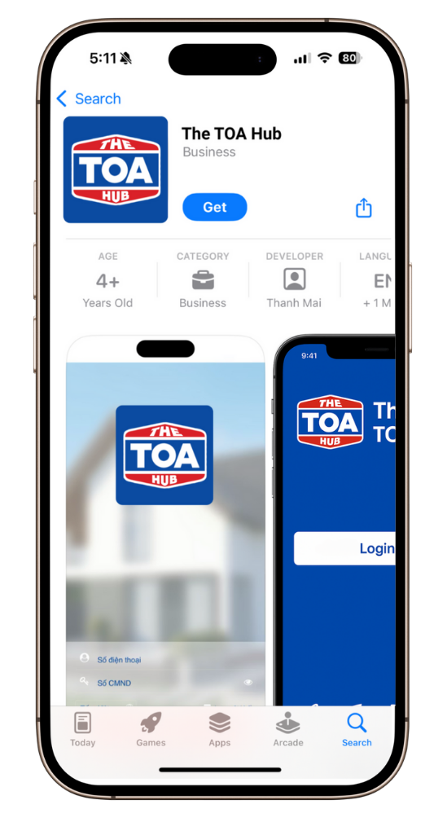

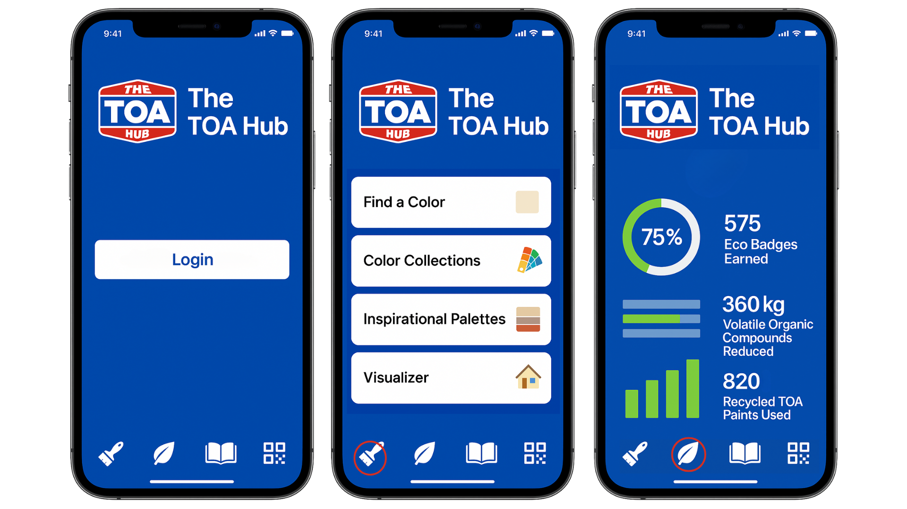
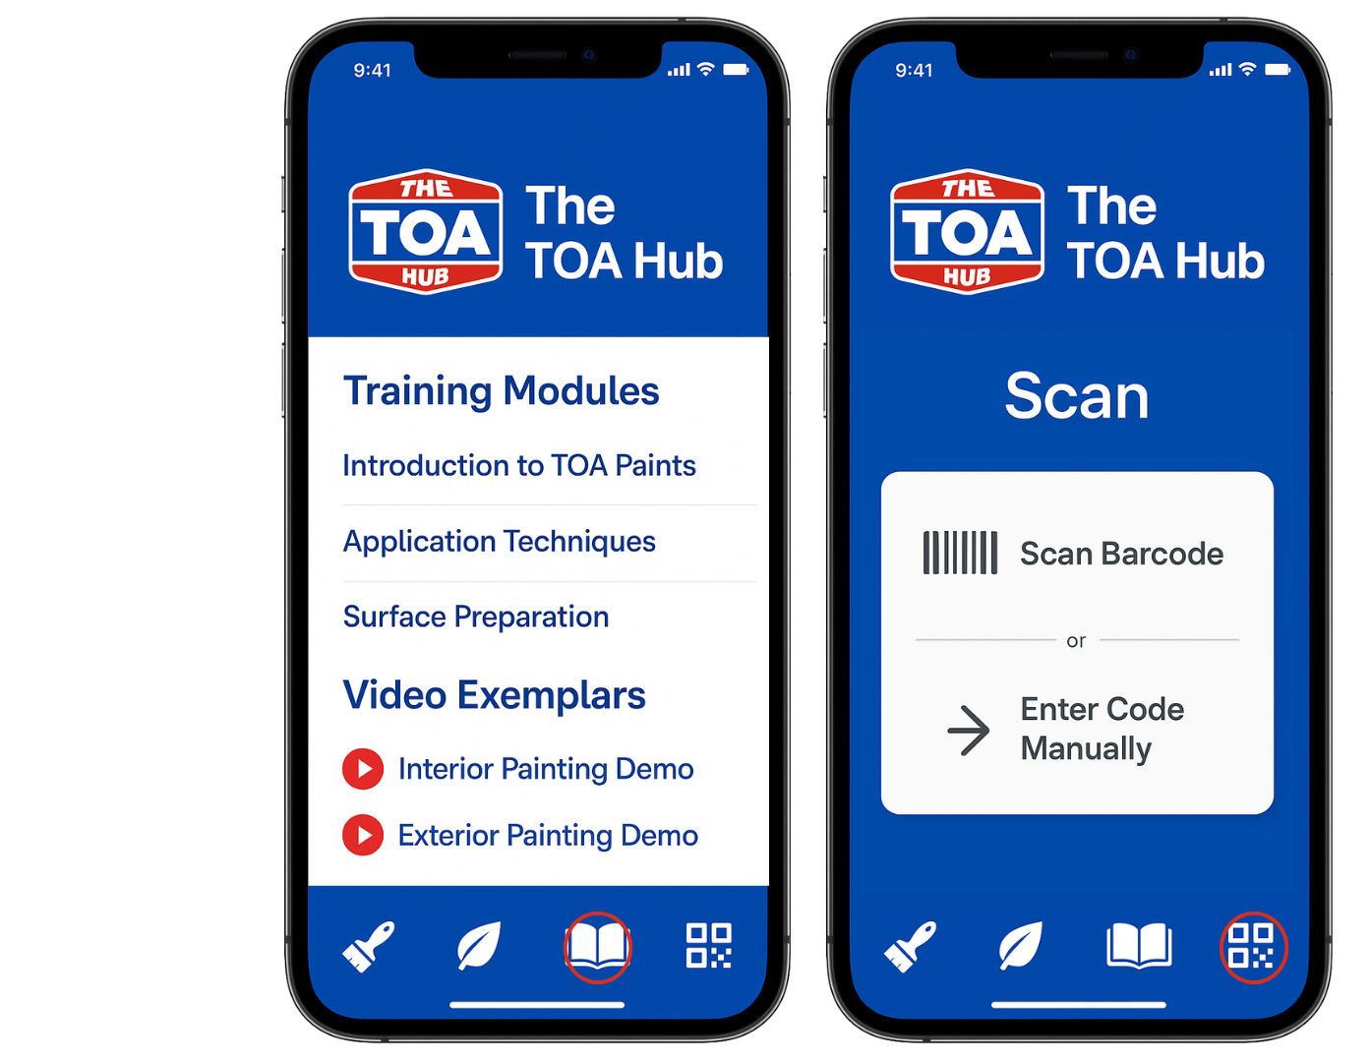
Redefining TOA.painter: Introducing The TOA Hub
The TOA Hub supports painters, retailers, and developers with certified training, rewards, and eco-incentives. It offers offline access for rural users, real-time inventory for retailers, and dashboards for contractor and sustainability tracking, empowering the industry with tools for growth, stability, and green impact.
Notes:
WHAT
Three different visuals about what the new application will look like for each segment (TOA.painter+, TOA.Project, TOA.green, etc logging in based on your segment ‘sign in as a distributor, sign in as a customer)

Slide 21
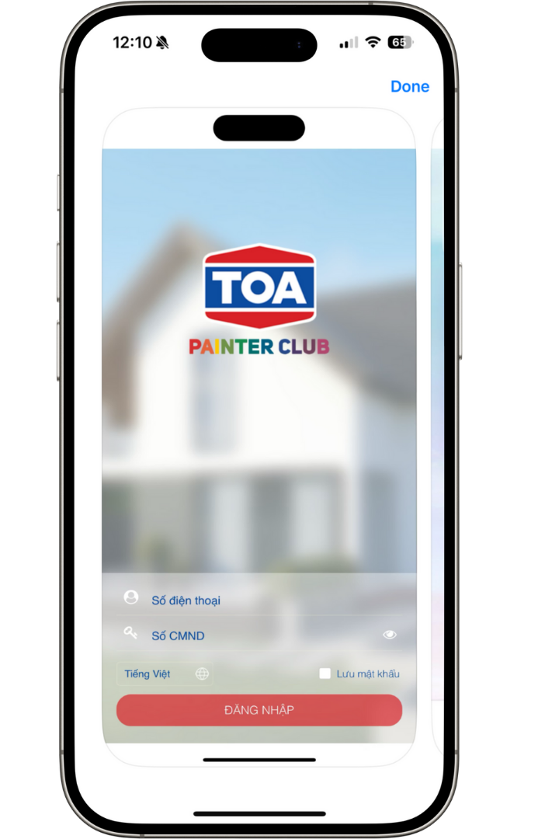
Building on TOA.painter can improve sustainable digital engagement
Promotion-Dependent Loyalty
Loyalty relies on discounts, users disengage after promotions.
Notes:
WHY
How the app TOA Painter app looks currently (what it's not currently doing)
Look into lacking in retail market and training for consistent sales processes (problem with inconsistency)

Slide 22
Building on TOA.painter can improve sustainable digital engagement
Promotion-Dependent Loyalty
Narrow User Targeting
Loyalty relies on discounts, users disengage after promotions.
App excludes retailers, developers, and passive homeowners
Notes:
WHY
How the app TOA Painter app looks currently (what it's not currently doing)
Look into lacking in retail market and training for consistent sales processes (problem with inconsistency)

Slide 23
Building on TOA.painter can improve sustainable digital engagement
Promotion-Dependent Loyalty
Narrow User Targeting
No Offline Functionality
Loyalty relies on discounts, users disengage after promotions.
App excludes retailers, developers, and passive homeowners
Internet required at all times, rural users excluded
Notes:
WHY
How the app TOA Painter app looks currently (what it's not currently doing)
Look into lacking in retail market and training for consistent sales processes (problem with inconsistency)

Slide 24
Building on TOA.painter can improve sustainable digital engagement
Promotion-Dependent Loyalty
Narrow User Targeting
No Offline Functionality
Limited Functional Value
Loyalty relies on discounts, users disengage after promotions.
App excludes retailers, developers, and passive homeowners
Internet required at all times, rural users excluded
Only receipt-scanning and points system, no pro tools
Notes:
WHY
How the app TOA Painter app looks currently (what it's not currently doing)
Look into lacking in retail market and training for consistent sales processes (problem with inconsistency)

Slide 25
Building on TOA.painter can improve sustainable digital engagement
Promotion-Dependent Loyalty
Narrow User Targeting
No Offline Functionality
Limited Functional Value
Loyalty relies on discounts, users disengage after promotions.
App excludes retailers, developers, and passive homeowners
Internet required at all times, rural users excluded
Only receipt-scanning and points system, no pro tools
The TOA Hub Difference:
TOA is not just selling paint - it's providing tools, training, and technology that elevate the entire value chain.
Notes:
WHY
How the app TOA Painter app looks currently (what it's not currently doing)
Look into lacking in retail market and training for consistent sales processes (problem with inconsistency)

Slide 26
Building on TOA.painter can improve sustainable digital engagement
Promotion-Dependent Loyalty
Narrow User Targeting
No Offline Functionality
Limited Functional Value
Loyalty relies on discounts, users disengage after promotions.
App excludes retailers, developers, and passive homeowners
Internet required at all times, rural users excluded
Only receipt-scanning and points system, no pro tools
The TOA Hub Difference:
Introduces tiered loyalty program rewards
Adds badges, recognition tiers, and career incentives
Notes:
WHY
How the app TOA Painter app looks currently (what it's not currently doing)
Look into lacking in retail market and training for consistent sales processes (problem with inconsistency)

Slide 27
Building on TOA.painter can improve sustainable digital engagement
Promotion-Dependent Loyalty
Narrow User Targeting
No Offline Functionality
Limited Functional Value
Loyalty relies on discounts, users disengage after promotions.
App excludes retailers, developers, and passive homeowners
Internet required at all times, rural users excluded
Only receipt-scanning and points system, no pro tools
The TOA Hub Difference:
Introduces tiered loyalty program rewards
Expands access to these segments
Wider reach across Vietnam's value chain
Adds badges, recognition tiers, and career incentives
Notes:
WHY
How the app TOA Painter app looks currently (what it's not currently doing)
Look into lacking in retail market and training for consistent sales processes (problem with inconsistency)

Slide 28
Building on TOA.painter can improve sustainable digital engagement
Promotion-Dependent Loyalty
Narrow User Targeting
No Offline Functionality
Limited Functional Value
Loyalty relies on discounts, users disengage after promotions.
App excludes retailers, developers, and passive homeowners
Internet required at all times, rural users excluded
Only receipt-scanning and points system, no pro tools
The TOA Hub Difference:
Introduces tiered loyalty program rewards
Expands access to these segments
Offers offline access mode
Wider reach across Vietnam's value chain
Unlocks adoption in rural and economy segments
Adds badges, recognition tiers, and career incentives
Notes:
WHY
How the app TOA Painter app looks currently (what it's not currently doing)
Look into lacking in retail market and training for consistent sales processes (problem with inconsistency)

Slide 29
Building on TOA.painter can improve sustainable digital engagement
Promotion-Dependent Loyalty
Narrow User Targeting
No Offline Functionality
Limited Functional Value
Loyalty relies on discounts, users disengage after promotions.
App excludes retailers, developers, and passive homeowners
Internet required at all times, rural users excluded
Only receipt-scanning and points system, no pro tools
The TOA Hub Difference:
Introduces tiered loyalty program rewards
Expands access to these segments
Offers offline access mode
Provides career tools, design services, retail training, operational insights, and ESG tracking - building loyalty, purpose, and utility beyond discounts
Wider reach across Vietnam's value chain
Unlocks adoption in rural and economy segments
Adds badges, recognition tiers, and career incentives
Notes:
WHY
How the app TOA Painter app looks currently (what it's not currently doing)
Look into lacking in retail market and training for consistent sales processes (problem with inconsistency)

Slide 30
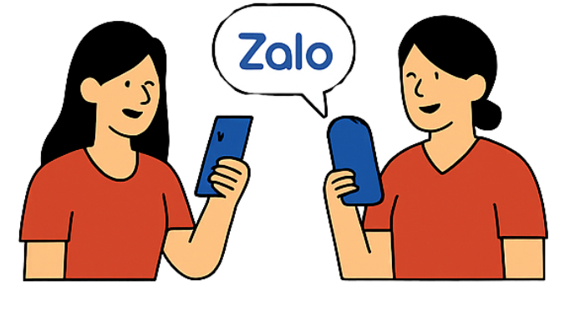

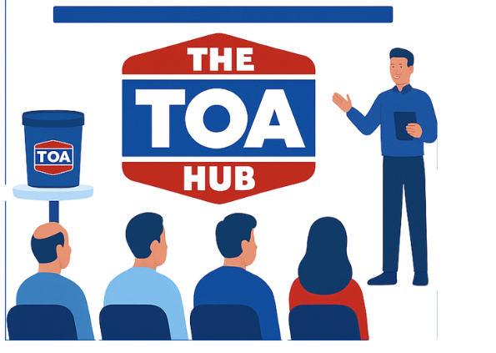
Promoting The TOA Hub: A multi-channel strategy that leverages both on-ground trust-building and digital efficiency
Vietnamese messaging app Zalo
TOA Product Distributors
Partnerships with Vocational Colleges
Strategic Partnerships with Green Building Certifiers & Associations
Paint training seminars with local distributors
Notes:
Application update (HOW): From App to Ecosystem: TOA+ Transformation Plan
Using existing code base expanding with the new features
V1 to sus out market
Training or marketing to have the solution liftoff

Slide 31
The 3-Tiered Strategy
May – June 2025
July – Sep 2025
Key:
Finalise recycling designs, set up data tracking and dashboards, explore grant opportunities
Four-month app dev+ testing period
Deploy bins, launch marketing, run trainings
Marketing user personas and research
Continue to monitor success of program with data
Recycling Pails
Refilling station
The TOA Hub
Jan – Dec 2026
Oct – Dec 2025
Enhance features for ESG, loyalty, and developers
Adjust available recycling points if needed
Integrate data, trainings, launch mobile paint refilling stations
Launch app to retailers and painters
Procure and outfit 2-3 vans, trainings
2027 - 2028
Publish impact statistics, review data for changes to strategy
Sources: …

Slide 32
The 3-Tiered Strategy
May – June 2025
July – Sep 2025
Key:
Finalise recycling designs, set up data tracking and dashboards, explore grant opportunities
Four-month app dev+ testing period
Deploy bins, launch marketing, run trainings
Marketing user personas and research
Continue to monitor success of program with data
Recycling Pails
Refilling station
Aspirational 3-Year Goal
Application build in four months, recycling project launch within one month and learnings from application adjusting paint refilling station location information for launch within 9 months
The TOA Hub
Jan – Dec 2026
Oct – Dec 2025
Enhance features for ESG, loyalty, and developers
Adjust available recycling points if needed
Integrate data, trainings, launch mobile paint refilling stations
Launch app to retailers and painters
Procure and outfit 2-3 vans, trainings
2027 - 2028
publish impact statistics, review data for changes to strategy
Sources: …

Slide 33
TOA is well positioned to achieve its financial goals in Vietnam through the implementation of the proposed strategy

Slide 34
Implementation of the strategy is expected to increase firm value by THB 449.9 million in perpetuity.
Cost reductions derived from in-house recycling and processing of High-Density Polyethylene (HDPE) and Polypropylene (PP) which are used in TOA’s paint packaging.
Increase in firm value by
THB 449.9m
via the implementation
Increase in revenue from greater awareness generated by TOA.hub.
Increase in revenue generated from TOA refill centre sales aggressively targeting the economy segment.

Slide 35
Operating projections paint a favourable growth story for TOA.
Cash Flows (Ongoing growth and viability)
Operating Cash Flow, 2028
THB 34.1 million
Operating Cash Flow, 2035
THB 86.3 million
Net Cash Flow, 2027 onwards
Positive
Net Cash Flow Growth, 2029 onwards
18% p.a.
The proposed strategy places TOA in a high growth, healthy cash position to continue expand its presence in Vietnam’s decorative paints market.

Slide 36
Breakeven by 2028 and financial feasibility is supported with robust costings.
Cost Breakdown (Costs over time per solution)
Key Points
Total CapEx spending across three solutions
THB 12.3 million
Total OpEx spending across three solutions
THB 10 to 14 million per year
Key Assumptions
Average Gallons per Pail = 5
This figure is used to estimate total pail use and downstream calculations for recycling potential. Sourced from industry norms.
60% of Pails Are Plastic
Assumes a fixed ratio of plastic to other types of pails, which drives the model's projected plastic recycling volumes.
Implementation Ramp-Up Rate
Only 25% of Vietnamese production is assumed to initially adopt the recycled pail solution, ramping up to 100% over time.
Use of conservative costings, with safety margins built into estimates allows TOA to have confidence in our projections.

Slide 37
The strategy fits within TOA’s financial goals and wider organizational objectives.
The strategy fits within TOA’s financial goals and wider organizational objectives.
Operational KPIs Driving Financial Viability
25% pail return rate across eligible products
Supports cost savings from recycled packaging
10+ mobile refill trucks deployed nationwide
Drives revenue from the economy segment
112,000 active users on the TOA Hub platform
Enables upselling, engagement, and reduces churn
80% of refills and returns tracked via QR
Improves logistics and cost control (linked to 66% fixed cost structure)
10,000 training modules completed via TOA Hub
Builds user expertise and loyalty, supporting retention assumptions in financials
10 tons of paint waste recycled annually
Aligns with ESG goals and supports favourable brand perception that underpins revenue growth
These KPIs are not just operational, they underpin the cost assumptions, revenue projections, and risk management built into our financial model.
Operational KPIs Driving Financial Viability:
→ 10+ mobile refill trucks deployed nationwide
→ Drives revenue from the economy segment (see Slide 3: refill centre revenue)
112,000 active users on the TOA Hub platform
→ Enables upselling, engagement, and reduces churn (supports growth in Slide 2 cash flow)
80% of refills and returns tracked via QR
→ Improves logistics and cost control (linked to 66% fixed cost structure in Slide 1)
10,000 training modules completed via TOA Hub
→ Builds user expertise and loyalty, supporting retention assumptions in financials
10 tons of paint waste recycled annually
→ Aligns with ESG goals and supports favourable brand perception that underpins revenue growth

Slide 38
Environmental only accounts for 4% of sales
Executive Summary
Eco-Conscious Shift
Underserved Markets
Digital Loyalty Gaps
Vietnamese homeowners are prioritising eco-friendly, non-toxic paints
TOA lacks presence in rural markets where local brands win with affordable paint
Painters, contractors, and retailers lack long-term engagement tools across all segments.
Insights
The economy segment makes up 32.7% of the market, but TOA holds just 3.2% share.
Inconsistent loyalty among medium-segment distributors
Low visibility in marquee real estate projects limits TOA’s premium presence.
Challenges
SHORTEN TEXT IN TEXTBOXES
- DOES “TOA” need to be in text
What strategic initiatives can TOA implement across the premium, medium, and economy segments to expand its market presence and establish a strong, sustainable position in Vietnam’s decorative paint market?
Question
A 3-Part Circular Paint Ecosystem to Drive Reach, Retention, and Responsibility
Strategy
Paint Pail Return Program supports ESG value and encourages product reuse
Mobile Refill Trucks increase rural access and expand economy market share
TOA Hub Platform builds long-term loyalty, tracks projects, and unites all users
THB 449.9m
Net Present Value
(NPV)
THB 34.1M
Operating Cash
Flow in 2028
3 Year
Payback period
achieved by Year 3
Impact
NPV
Operating cash flow 2028
Breakeven in 3 years

Slide 39
Q&A Index
Insights | Recycling Pails | Mobile Refilling | TOA.hub | Finances & Other
Starting slide | Starting slide | Starting slide | Starting slide | Starting slide
1. Aspirational 3-Year Goal (2025–2028) & KPIs | 2. Segment Values | 3. Segment Values | 4. Segment Values | 5. Finance - Market Sizing Vietnam from TOA Financials | 6. Ideas generated | 7. Finances – Recycled Paint Pail, Revenue Assumptions
8. Competitive analysis | 9. Marketing 7P’s | 10. Marketing 7P’s | 11. Marketing 7P’s | 12. Finances – Market Sizing Vietnam from Case Brief | 13. Finances – Recycled Paint Pail, Revenue Schedule | 14. Finances – Recycled Paint Pail, CapEx and OpEx Schedule
15. Market Share by Segment | 16. Dulux case study |  | 17. The TOA Hub Value. | 18. Finances – Recycled Paint Pail, CapEx and OpEx Assumptions | 19. Finances – TOA.hub, Revenue Schedule | 20. Finances – TOA.hub, Revenue Assumptions
 |  |  |  | 22. Finances – TOA.hub, CapEx and OpEx Schedule | 23. Finances – TOA.hub, CapEx and OpEx Assumptions | 24. Finances – Refill Stations, Revenue Schedule
 |  |  |  | 25. Finances – Refill Stations, Revenue Assumptions | 26. Finances – Refill Stations, CapEx and OpEx Schedule | 27. Finances – Refill Stations, CapEx and OpEx Assumptions
 |  |  |  | Finances – Other Assumptions, WACC Sensitivity | Finances – Back working TOA Pricing 1 | Finances – Back working TOA Pricing 2

Slide 40
Dulux Case Study
Dulux’s Project Earth is a sustainability initiative aimed at diverting thousands of tonnes of plastic paint packaging—such as water-based paint drums, pails, and tear strips—from landfill. Launched two years ago with a pilot in Queensland, the project enables construction companies to recycle these plastics, which are reprocessed into items like roller trays.
The initiative benefits construction companies by reducing disposal costs and boosting their sustainability credentials, while helping Dulux lead as a green supplier. A single year of tear strip use by Dulux Trade generated 28 tonnes of plastic, expected to rise to 54 tonnes—showcasing the scale of impact.
So far, 12 pilot sites in Brisbane have diverted 42 tonnes of plastic and saved builders over $247,000 in waste costs. Dulux became the first to receive EPA Product Stewardship Endorsement in Queensland, allowing them to legally remove empty drums from sites.
The program is now set to expand nationally, pending EPA approvals in Victoria and Western Australia, with 15 sites in Victoria and 17 in NSW ready to join.
https://www.duluxgroup.com.au/work-with-us/our-stories/dulux-project-earth-to-go-national/

Slide 41



Recycling Pails
Customers
Company
Premium: Reduced price points for large-scale development projects & decreased environmental impact for green builds
Medium: Opportunity to earn partial rebate from returned pails
Economy: Reduced price point for price-sensitive consumers
Vision includes providing environment friendly products that cater to customers’ needs
Goal to be net zero by 2025
Anticipated decrease in packaging manufacturing costs and increased sales advances TOA’s market share
Increased brand awareness and loyalty
Decreased price points to generate revenues for economy sector
Capitalise on enviro-friendly strengths
Strategic entry into premium market with improved strategy for price negotiations
Collaborators
Government:
Promotes circular economy
Reduces plastic waste and toxic plastic entering waterways and landfill
Sources: …

Slide 42
Paint refilling stations
Customers
Company
Premium: N/A
Medium: N/A
Economy: Localised supply chain, reducing time to retrieve paint. Reduced price point for using refillable pails
Vision includes providing environment friendly products that cater to customers’ needs
Goal to be net zero by 2025
Anticipated decrease in packaging manufacturing costs and first-movers advantage advances TOA’s market share
Increased brand awareness and loyalty
Decreased price points to generate revenues
Collaborators
Government:
Promotes circular economy
Reduces plastic waste and toxic plastic entering waterways and landfill
Sources: …

Slide 43
TOA.hub application
Customers
Company
See next slide
Drives sales in medium segment, where TOA traditionally has lacked
Centralized training and dashboarding for benefits to all segments to drive revenues and sales
Collaborators
N/A
Sources: …

Slide 44
The TOA Hub provides tools, training, and technology that elevate the entire value chain.
Economy Segment
Medium Segment
Premium Sector
Challenges
Low brand loyalty
Price-driven behavior
Limited access to training or consistent supply
Poor internet connectivity in rural areas
Challenges
Inconsistent promotions
Low transparency in reward tracking
No structured painter engagement
Challenges:
Low visibility for TOA
Loyalty to incumbents like Jotun, Nippon
Lack of ESG/compliance tools
The TOA Hub Solution:
Offline access supports rural and low-tech users
Basic training modules and tiered certifications build capability and trust
Non-price loyalty: Points from recycling, repainting, and app use shift focus from discounts
The TOA Hub Solution
Real-time reward tracking builds transparency and motivation
Retail staff and painter training via the app improves service and loyalty
Inventory visibility and contractor team dashboards support growing paint shops
Gamified eco-incentives increase engagement beyond temporary promotions
The TOA Hub Solution:
Green building scoring tools and eco dashboards for ESG compliance
Specification libraries and procurement tools streamline large project workflows
Certified painter look-up enhances trust and quality assurance
Project tracking metrics show sustainability progress and strengthen partnerships
Notes:
WHY
Talk about adding value for each segment in this part, how it will be implemented
Channels for marketing

Slide 45
Why The TOA Hub App Is a Strong Fit for Vietnam
Reason | Explanation
1. Trust is built offline | Vietnamese painters and contractors often rely on face-to-face relationships and community networks. The TOA Hub combines in-person promotion (e.g., seminars, retailer support) with a trusted digital tool for continuous engagement.
2. High mobile usage, but not always high-spec | Over 70% of the population owns a smartphone, but rural areas often have basic models and weak internet. TOA Hub is built with low-data, offline-access features, ensuring usability even in remote villages.
3. Price-sensitive, loyalty-driven market | Especially in the economy and mid-tier segments, users respond well to rewards and promotions. The TOA Hub’s gamified point system, loyalty badges, and scan-to-earn tools give users visible, trackable benefits.
4. Ecosystem-centric buying behavior | Painters rely on retailers, team foremen, and site contractors for advice. The TOA Hub connects these players in one digital space, making TOA more embedded in day-to-day decision-making.
5. Vocational and youth engagement is rising | Vietnam’s push toward vocational education and digital literacy means young painters and shop owners are more open to learning and growing via digital platforms like TOA Hub.
6. Growing ESG & government sustainability agenda | Vietnam is committed to net-zero by 2050, and developers are under pressure to meet green building standards. The TOA Hub supports this through VOC dashboards, pail recycling tracking, and certified green tools.
7. Zalo-driven & mobile-first communication | Most Vietnamese users prefer Zalo and mobile apps over websites or email. TOA Hub integrates naturally into these behaviors with notifications, reminders, and social sharing potential.
Notes:
WHY
Talk about adding value for each segment in this part, how it will be implemented
Channels for marketing

Slide 46
Rejected / Low-Priority Strategic Ideas for TOA Vietnam
Solution | Customer Value | Collaborator Value | Company Value | Feasibility/Fit | Why It Doesn't Work for TOA Vietnam
Opening TOA-branded paint retail stores (B2C exclusive) | 2/4 | 1/4 | 2/4 | 1/4 | High setup cost, competes with existing retail partners; misaligned with TOA’s strong B2B distributor model.
Premium-only expansion strategy | 2/4 | 2/4 | 2/4 | 2/4 | Vietnam’s volume comes from economy and mid-tier demand; over-focus on premium limits total market capture.
Offering credit financing to painters | 1/4 | 2/4 | 2/4 | 1/4 | High risk of default, hard to scale without strong fintech/collections infrastructure
Luxury design collaborations (e.g., with interior designers) | 2/4 | 1/4 | 1/4 | 2/4 | Too niche for mass-market Vietnam strategy; limited reach beyond premium tier and high-end urban projects.
Exclusive online sales platform (TOA only) | 1/4 | 1/4 | 2/4 | 1/4 | Undermines existing distribution network; digital-only model doesn’t align with painter buying habits.

Slide 47
Why is The TOA Hub different to competitors?
Category | TOA Hub | Typical Competitors (e.g. Nippon, Jotun, Dulux)
End-to-End Platform | Multi-user app for painters, retailers, contractors, developers — not just a painter loyalty app | Mostly separate platforms or campaigns per audience; often focused on one-off promotions
Training & Certification | In-app training modules, tiered painter certifications, floodproof and eco modules | Some offline painter training events; no integrated certification tracking via app
Loyalty & Rewards | Integrated rewards linked to QR scans, pail returns, eco badges, job-matching, and usage | Focuses on product promotions or bulk discounts; no circular reward system tied to eco or app actions
Retailer Integration | Tools for retailers to manage inventory, team training, and promotions | Retailers engaged mainly via field reps or static POS materials
Contractor/Developer Tools | ESG dashboards, spec sheet libraries, project tracking, certified painter lookup | Limited or no digital support for developers or ESG alignment
Eco Circularity Features | Ties into recycling programs, mobile refill tracking, VOC reporting | Competitors often push “eco paint” as a product, but lack full lifecycle tracking
Offline Access & Inclusivity | Designed for rural painters, low-data access, and mobile-friendly features | Apps or systems often urban-focused and assume higher smartphone literacy
Family & Team Dashboards | Users can manage personal + team/contractor performance in one place | Few (if any) competitors support multi-user dashboard experience
The TOA Hub differentiates itself from competitors.
  Jotun and Nippon have apps – but they’re limited to colour selection or consumers ordering. The TOA Hub builds relationships and rewards across the full value chain.

Slide 48
The Marketing 7P’s: Recycling Paint Pails
Product | A paint pail return-and-reward program that encourages customers (painters, retailers, contractors) to return used TOA paint pails for: • Recycling • Reuse in refill programs • Conversion into paint accessories or sustainable packaging
Price | • Customers receive discounts, cash-back, or loyalty points per returned pail • Tiered incentives for higher return volumes • Recycled pails reduce production costs, enabling cost-effective pricing in economy segments
Place | • Return points at partner retailers, refill stations, and training events • Collection bins in modern trade stores and construction zones • Integrated into mobile refill trucks in rural areas
Promotion | • “Return to Earn” awareness campaign • In-app tracking through The TOA Hub • On-pail QR codes with return instructions • Promoted at refill stations, seminars, stores, and on social media as part of TOA’s sustainability story
People | • TOA sales reps and retail partners educate users on how/where to return pails • Field agents at refill stations log returns and reward users • Internal teams track volumes and ensure process transparency
Process | • Simple return process: clean pail → scan or log in app → drop off → receive reward • Points tracked in the TOA Hub app or via receipt • Bulk returns by contractors/retailers managed monthly or quarterly
Physical Evidence | • Branded TOA return bins, eco-certification stamps on new pails • Visual dashboard in the app (e.g., “You’ve returned 27 pails – 6kg plastic saved!”) • In-store posters, truck stickers, and loyalty gift items made from recycled pails

Slide 49
The Marketing 7P’s: The TOA Hub
Product | A mobile platform tailored to each user: • Painters: training, certifications, rewards, job-matching • Retailers: inventory tracking, staff training • Contractors: manage painter teams, bonuses • Developers: ESG dashboards, spec sheets, procurement tools
Price | • Free app access for all users • Earnable rewards and loyalty points • Tiered benefits for high engagement (e.g., discounts, referrals, app-exclusive perks)
Place | • Available on App Store & Google Play • Promoted at training seminars, retailers, vocational colleges • Distributed via TOA workshops, reps, and pop-up events
Promotion | • Seminars and distributor-run workshops • In-store QR displays and onboarding materials • Social media (Zalo, Facebook groups) • Co-branded campaigns with developers and certifiers
People | • TOA trainers, retail partners, and reps onboard and assist users • Certified painters and retailer “champions” as local advocates • Developer support by TOA B2B sales team
Process | • Segment-specific onboarding flows • Clear, gamified journey (certifications, points, eco badges) • Seamless booking, scanning, and tracking of progress
Physical Evidence | • TOA-branded UI and app visuals • In-app certifications and eco-impact dashboards • Printed marketing materials, loyalty gifts, and on-site signage

Slide 50
The Marketing 7P’s: Mobile Paint Service
Product | Affordable, economy-line TOA paint offered through mobile refill trucks. Available in commonly used colors. Paint sold by volume; packaging-free.
Price | Lower-than-retail pricing due to elimination of packaging and transport margins. Incentives like bulk refill discounts and loyalty points via TOA+ App.
Place | Mobile refill units stationed in rural villages, local markets, or near construction sites on a rotating schedule. Boosts last-mile accessibility.
Promotion | Partner with local paint shops, community leaders, and Zalo groups for word-of-mouth and scheduling awareness. Add on-truck branding and megaphone callouts. Promote via TOA Hub.
People | Staffed by trained TOA agents or local franchise partners who can educate users, demonstrate refills, promote TOA+ app sign-up, and collect returned pails.
Process | Simple, fast refill: bring clean container → pay or redeem app points → refill. Option to scan code on pail to track loyalty. Receipts can be printed or sent by SMS/Zalo.
Physical Evidence | Branded TOA mobile refill trucks, signage at refill spots, reusable containers with TOA markings. Provide refill cards or digital app logs showing refills + savings.

Slide 51
Channel Strategy of The TOA Hub
Paint training seminars with local distributors | Builds trust and app adoption through face-to-face interaction with key end-users; aligns with TOA’s current seminar/training seminars.
Partner retailers | Retailers are influential in painter decision-making and serve as trusted advisors; they can also use the app internally for staff training, reward tracking, and promotional integration.
Leveraging Vietnamese platforms such as Zalo | With 87% of the country’s smartphone users active on Zalo, it is the most-used messaging app in Vietnam. Zalo had over 75 million monthly active users in Vietnam as of 2024, outpacing Facebook Messenger for business and local communication. Companies can make Official Accounts to promote to consumers.
Partnerships with Vocational Colleges in Vietnam | Reaches future painters early; helps embed TOA skills, certifications, and app use into their training and career development. Vietnam has over 400 vocational and technical colleges; government policies encourage digital skill-building for construction and technical trades
Co-Branded ESG Toolkit Integration (LOTUS, EDGE, etc.) | Collaborate to embed The TOA Hub’s green paint products, VOC metrics, and packaging data into these certifiers’ scoring tools (LOTUS, EDGE, etc.). Provide developers using these certifications with automatic access to TOA’s eco metrics dashboard via the app. Green building certifications like LOTUS and EDGE are gaining traction, especially with Vietnam’s goal of net-zero by 2050 and increasing ESG pressure on developers

Slide 52
Aspirational 3-Year Goal (2025–2028)
Establish TOA among Vietnam’s top 4 decorative paint brands within 3 years by scaling a circular ecosystem that expands rural reach, strengthens digital loyalty, and leads on sustainability.
Grow TOA’s decorative paint market share in Vietnam from 4.7% to 8% by 2028 through a circular ecosystem strategy focused on access, loyalty, and sustainability.
Supporting KPIs:
25% pail return rate across eligible products
10+ mobile refill trucks deployed nationwide
112,000 active users on the TOA Hub platform
80% of refills and returns digitally tracked via QR codes
10,000 training modules completed through TOA Hub
10 tons of paint waste recycled annually

Slide 53
Competitive Analysis
Brand | Strengths | Weaknesses | Vietnam Market Position | Key Highlights
Jotun | Strong government ties, premium project focus, top-of-mind awareness | Limited variety, low distributor margins | #1 in Premium (36.5%) | Dominates premium, entrenched in government-linked projects
AkzoNobel | Strong CRM, consistent ATL/BTL campaigns, broad segment coverage | High pricing, diluted image due to counterfeits | Top 3 across all segments | Consistently visible but faces trust and affordability gaps
Nippon Paint | Painter-focused app programs, public CSR projects, national awareness | Short-term loyalty, less brand stickiness | Top 3 in Economy and Premium | Leads with digital and CSR, lacks deep loyalty retention
4Oranges | Dominates rural areas, creative mass-market campaigns, diversified sub-brands | Brand overlap, minimal premium/project visibility | #2 in Economy | Strong rural play, but weak in premium and institutional
TOA | ESG-certified products, growing retail presence, building loyalty platform | Weak economy penetration, low rural awareness, limited real estate presence | 7.0% Premium, 4.0% Medium, 3.2% Economy | Quality-driven with ESG edge, needs reach and visibility
TOA’s competitors each lead in a specific advantage: project relationships, digital loyalty, or rural access. TOA’s opportunity lies in integrating all three through a circular ecosystem strategy that delivers reach, loyalty, and sustainability at scale.

Slide 54
TOA Market Share by Segment
Segment | TOA’s Share | Rank
Premium | 7.0% | 4th place
Medium | 4.0% | 6th place
Economy | 3.2% | 6th place
Overall estimated | ~4.7% total market share | Not in Top 4 overall
Top brands overall: Jotun, AkzoNobel, Nippon Paint, 4Oranges
TOA trails behind due to lower share in medium and economy segments

Slide 55
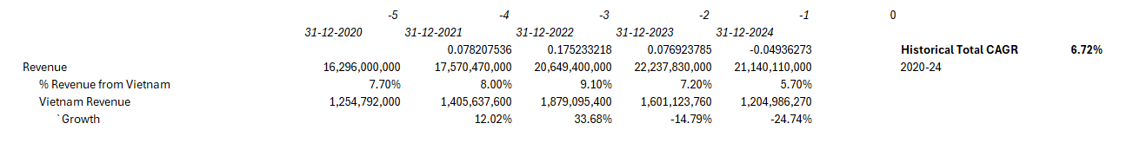
Finances – Market Sizing Vietnam from TOA Financials

Slide 56
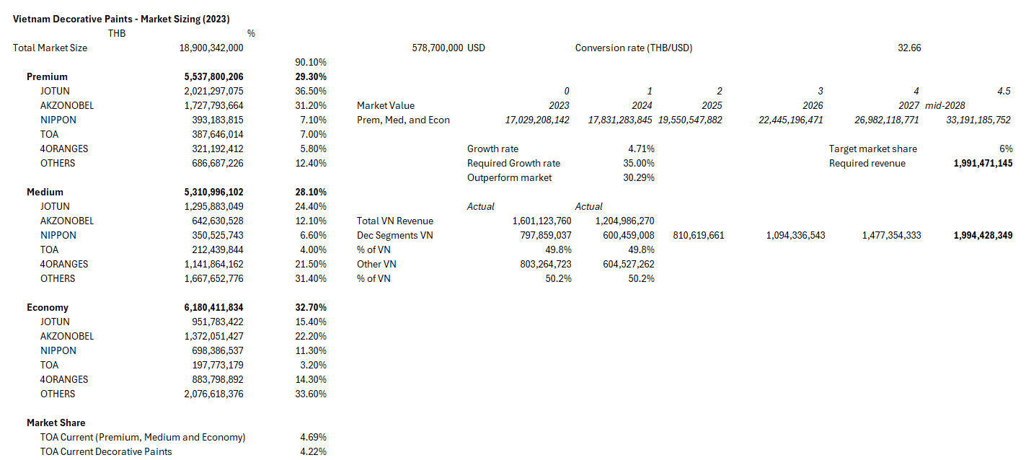
Finances – Market Sizing Vietnam from Case Brief

Slide 57
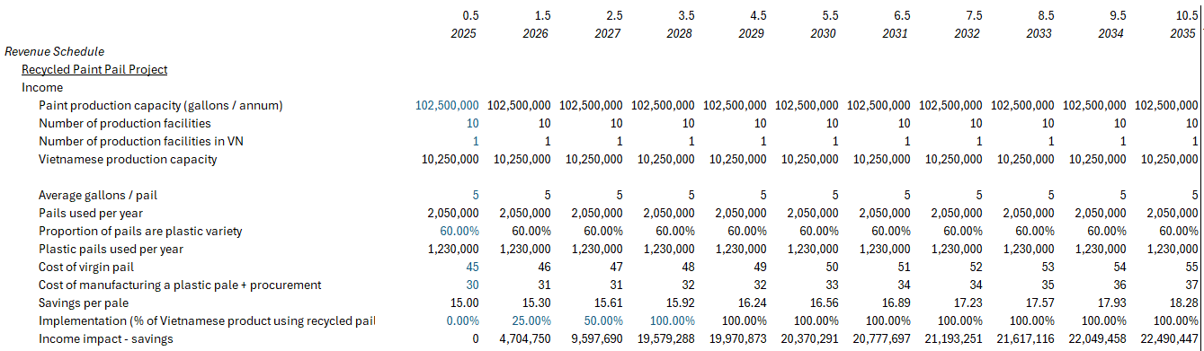
Finances – Recycled Paint Pail, Revenue Schedule

Slide 58
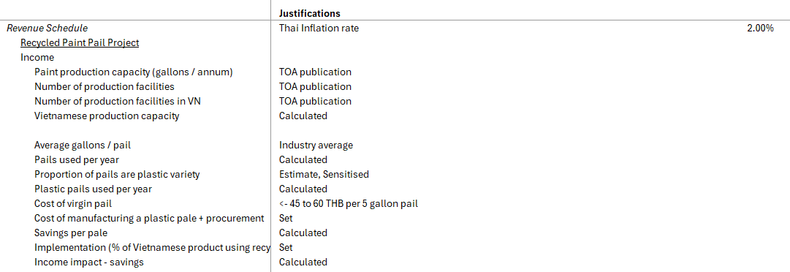
Finances – Recycled Paint Pail, Revenue Assumptions

Slide 59
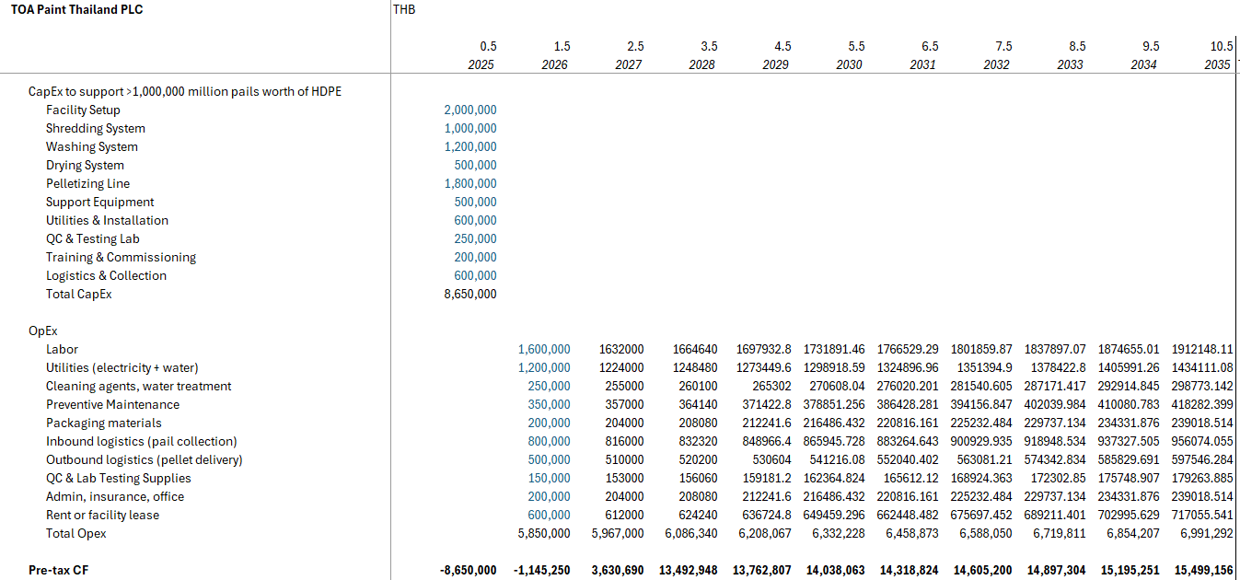
Finances – Recycled Paint Pail, CapEx and OpEx Schedule

Slide 60
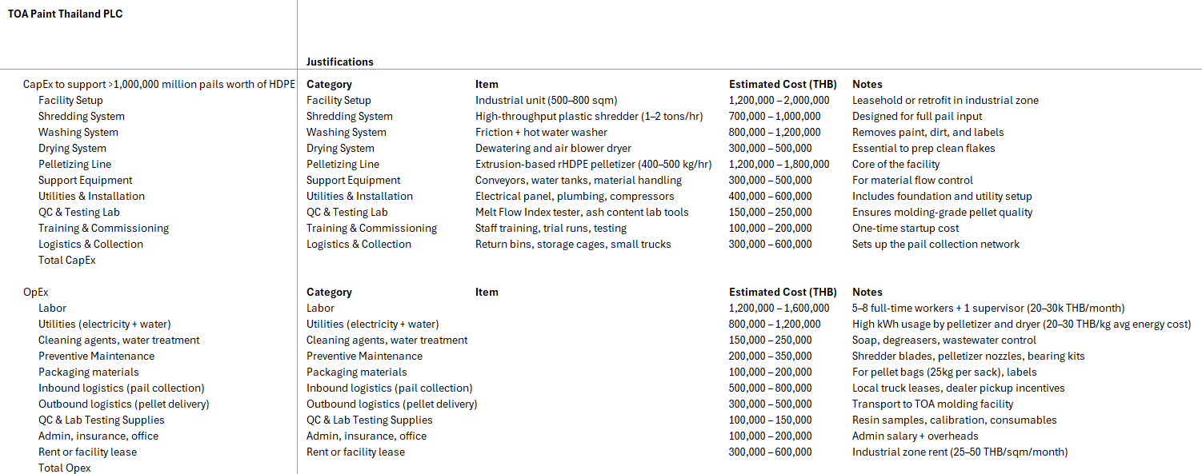
Finances – Recycled Paint Pail, CapEx and OpEx Assumptions

Slide 61
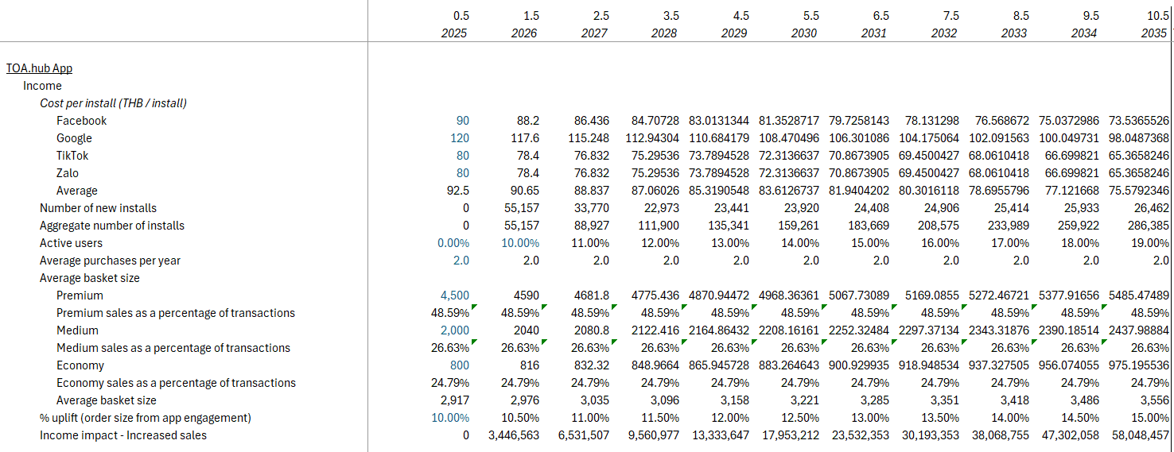
Finances – TOA.hub, Revenue Schedule

Slide 62
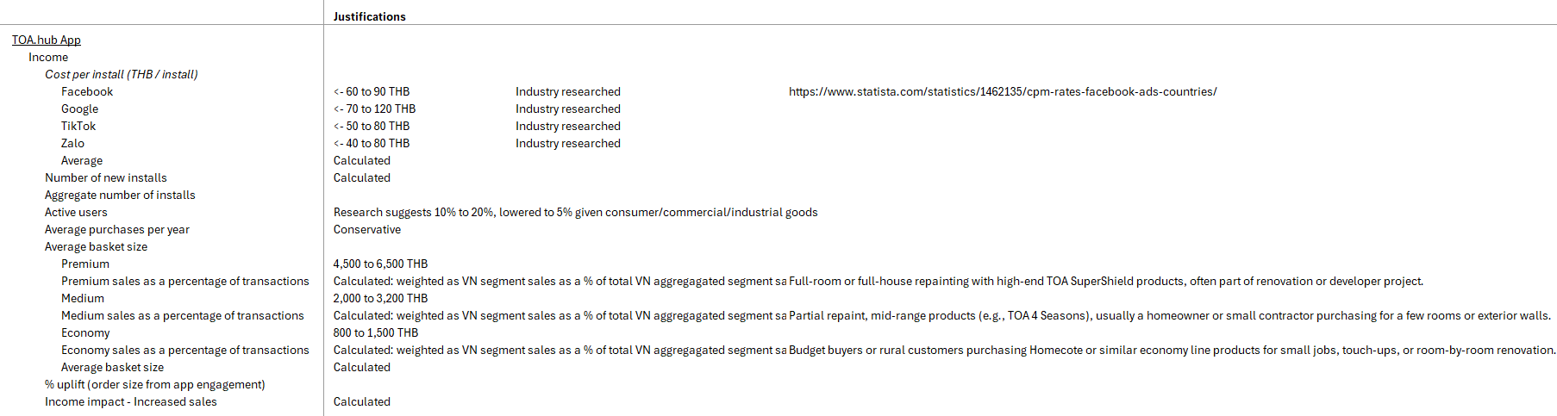
Finances – TOA.hub, Revenue Assumptions

Slide 63
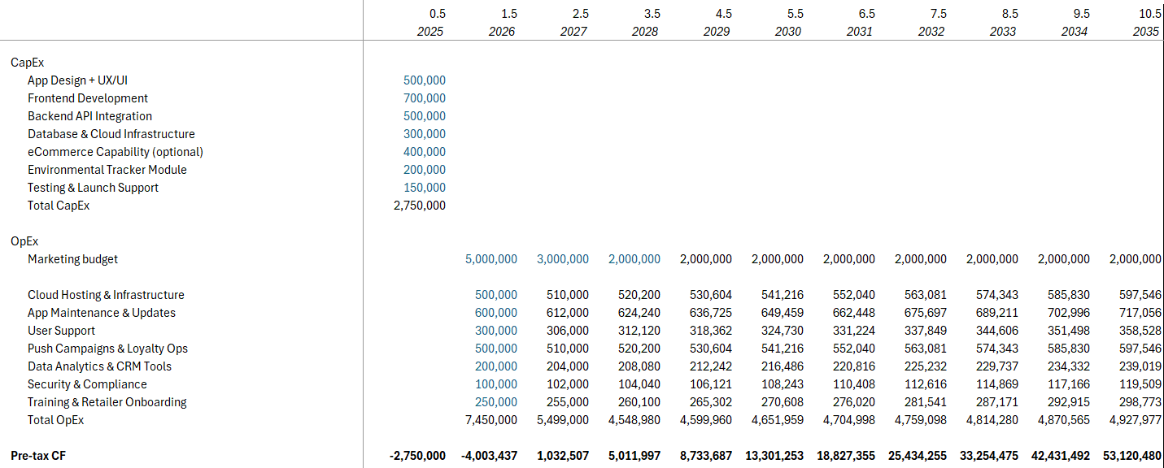
Finances – TOA.hub, CapEx and OpEx Schedule

Slide 64
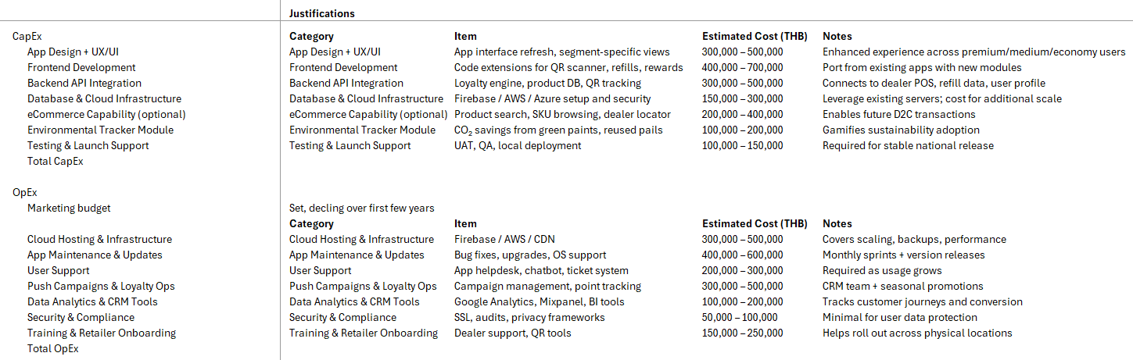
Finances – TOA.hub, CapEx and OpEx Assumptions

Slide 65
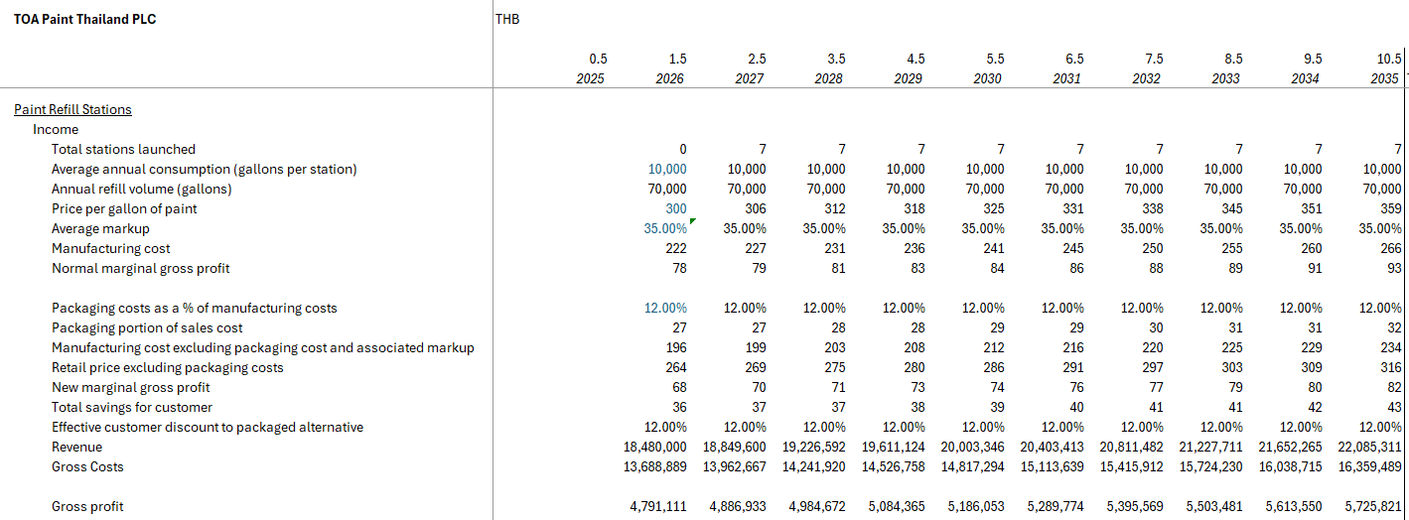
Finances – Refill Stations, Revenue Schedule

Slide 66
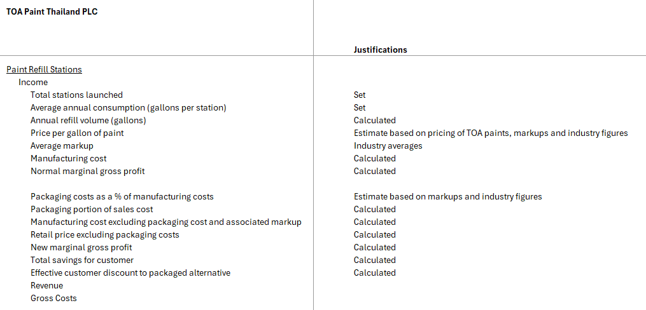
Finances – Refill Stations, Revenue Assumptions

Slide 67
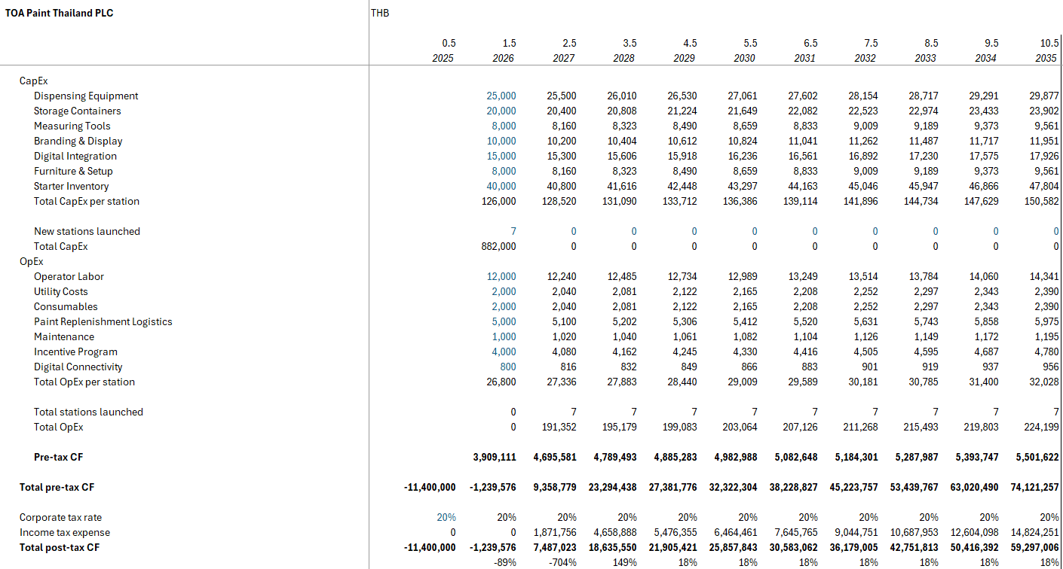
Finances – Refill Stations, CapEx and OpEx Schedule

Slide 68
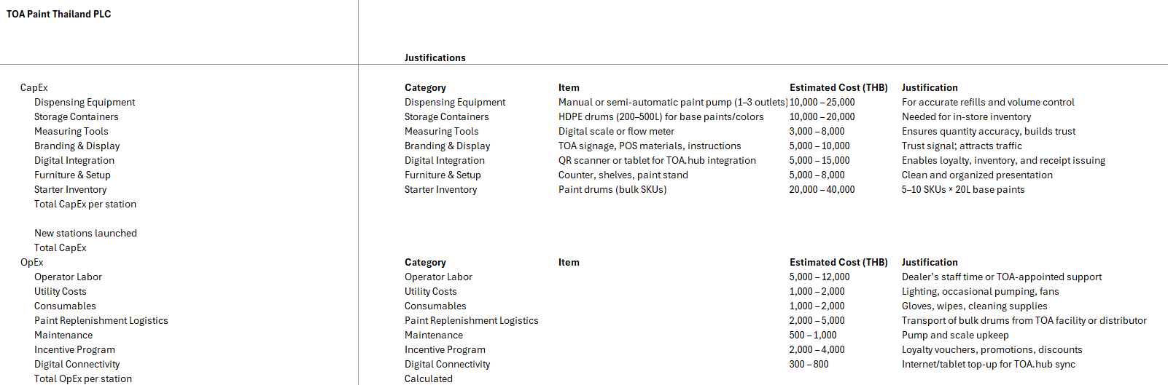
Finances – Refill Stations, CapEx and OpEx Assumptions

Slide 69
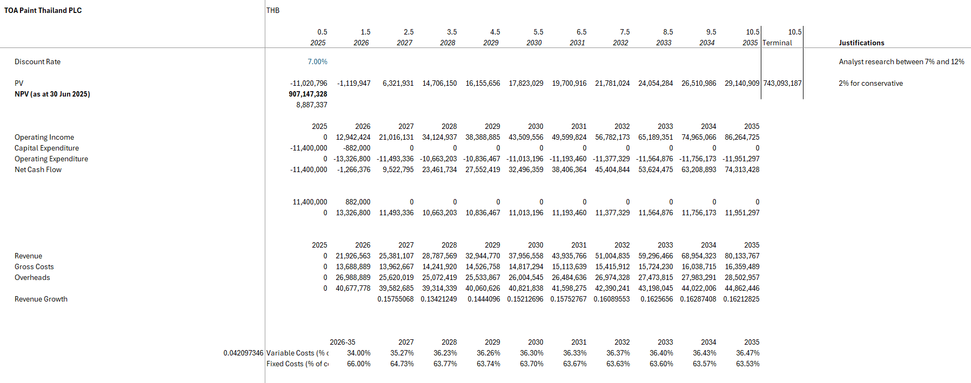
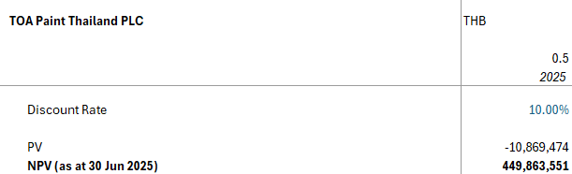
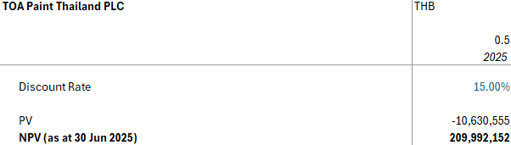
Finances – Other Assumptions, WACC Sensitivity

Slide 70
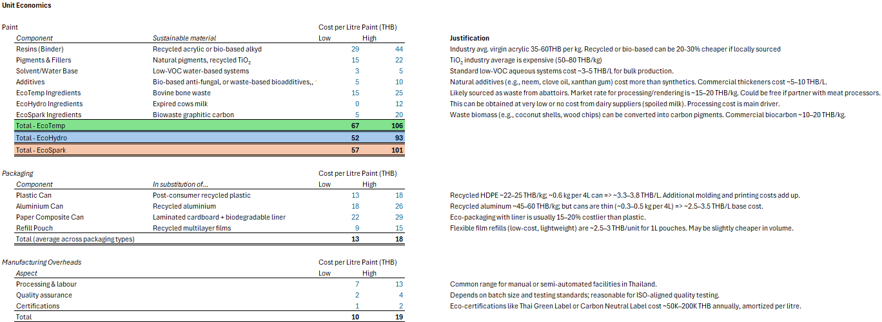
Finances – Back working TOA Pricing 1

Slide 71
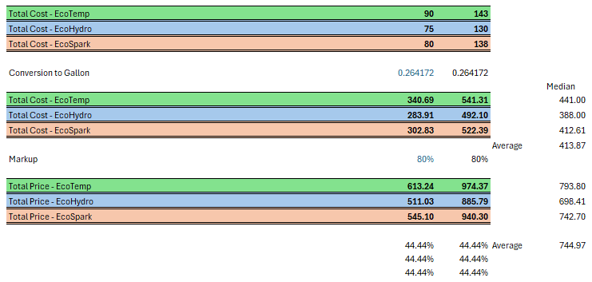
Finances – Back working TOA Pricing 2

