Slide 1


Repositioning Phyathai as Thailand’s Wellness Brand of Choice
Cameron Mah, Kate Bellars, Abbey Caller, Matthew Huehne

Slide 2



Executive Summary
BUT THERES A GAP
Wellness Market Boom
Digital-First Demand
Underused Service Potential
Thailand’s wellness market grew 28.4% year-on-year in 2023
Consumers expect digital, personalised wellness, and many already use apps to manage their health.
Phyathai’s wellness services are strong, but not packaged or promoted in a way that drives long-term use.
Insights
Wellness services are strong, but not packaged in a way that encourages long-term use.
Key consumer segments aren’t being actively targeted or engaged.
Digital tools like HealthUp are not being fully used to grow the wellness offering.
Issues
How can Phyathai grow its preventive and wellness services by 30% and become the top of mind health and wellness destination for the mid-high income segment in 3 years?
Question
Repackage Phyathai’s current wellness services into lifestyle-based bundles, delivered through an updated WellnessHub, built from the existing HealthUp app.
Strategy
Offers modular wellness bundles tailored to lifestyle goals
Builds a digital hub for seamless personalised care
Activates targeted campaigns to boost engagement and loyalty
THB 212m
Increase in
3-year NPV
THB 4.45b
3-year Projected Revenue
+17.52%
Net Profit Margin
(2026-2028)
Impact

Slide 3
Wellness demand is rising, but Phyathai’s current positioning leaves opportunity on the table.

Slide 4






Current offerings aren’t designed to meet lifestyle-driven expectations
https://www.bain.com/insights/asia-pacific-front-line-of-healthcare-2024/
Missed Consumer Connection
Underused Digital Tools
🔹 1. The Strategic Gap
Phyathai offers strong wellness services (checkups, skin, dental, vaccines)
But services are presented as clinical and transactional, not lifestyle-driven
Customers don’t see clear value or emotional appeal
🔹 2. Missed Consumer Connection
High-potential segments like “Living Life and Looking Good” want services that fit goals like energy, appearance, and long-term vitality
“Self-Reliant” users want convenience, control, and fast access
Current offering is not built around these goals or motivations
🔹 3. Underutilised Digital Tools
HealthUp and CRM exist but are not positioned as engagement or wellness tools
Lack of rebooking flow, journey tracking, or lifestyle bundling
This results in low repeat usage and weak long-term engagement
The Strategic Gap
Wellness services are available, but feel clinical and lack lifestyle appeal.
Current services don’t reflect the goals or routines of key segments.
Existing platforms like HealthUp aren’t used to build loyalty or repeat visits.

Slide 5





Thai consumers are ready for lifestyle wellness that fits their daily lives
Wellness Market Growth
Shift to preventive, everyday care
Rising demand for convenience
Thailand’s private hospital sector is expected to reach
฿322B in 2024, with 8% annual growth
74% of Thais engage in wellness for long-term health and energy, not just treatment
91% of APAC consumers want a single platform to manage their health and wellness
Thai consumers are ready for lifestyle wellness that fits their daily lives
Anti-aging, skin, and preventive services are top growth categories
Wellness checkups and anti-aging treatments account for the majority of Phyathai’s wellness revenue
Hybrid care is now the norm. People want care they can control on their phone
Sources: Bain (2024), SCB Research, (2025)
https://www.bain.com/insights/asia-pacific-front-line-of-healthcare-2024/

Slide 6



Thai consumers are ready for lifestyle wellness that fits their daily lives
Wellness Market Growth
Shift to preventive, everyday care
Rising demand for convenience
Thailand’s wellness market grew 28.4% year-on-year in 2023
74% of Thais engage in wellness for long-term health and energy, not just treatment
91% of APAC consumers want a single platform to manage their health and wellness
Anti-aging, skin, and preventive services are top growth categories
Wellness checkups and anti-aging treatments account for the majority of Phyathai’s wellness revenue
Hybrid care is now the norm. People want care they can control on their phone
Sources: Bain (2024), SCB Research, (2025)
https://www.bain.com/insights/asia-pacific-front-line-of-healthcare-2024/

Slide 7
Thai consumers are ready for lifestyle wellness that fits their daily lives
Wellness Market Growth
Shift to preventive, everyday care
Rising demand for convenience
Thailand’s wellness market grew 28.4% year-on-year in 2023
74% of Thais engage in wellness for long-term health and energy, not just treatment
91% of APAC consumers want a single platform to manage their health and wellness
Anti-aging, skin, and preventive services are top growth categories
Wellness checkups and anti-aging treatments account for the majority of Phyathai’s wellness revenue
Hybrid care is now the norm. People want care they can control on their phone
1
Self-Reliant and Individualistic: professionals navigating changing family roles and seeking convenient, independent care
2
Living Life and Looking Good:
image-conscious Gen Y consumers prioritising appearance, energy and confidence
Sources: Bain (2024), SCB Research, (2025)
https://www.bain.com/insights/asia-pacific-front-line-of-healthcare-2024/

Slide 8



Thai consumers are ready for lifestyle wellness that fits their daily lives
Wellness Market Growth
Shift to preventive, everyday care
Rising demand for convenience
Thailand’s wellness market grew 28.4% year-on-year, reaching $40.5B in 2023
฿322B in 2024, with 8% annual growth
74% of Thais engage in wellness for long-term health and energy, not just treatment
91% of APAC consumers want a single platform to manage their health and wellness
and this is where the WellnessHub fits in.
Anti-aging, skin, and preventive services are top growth categories
Wellness checkups and anti-aging treatments account for the majority of Phyathai’s wellness revenue
Hybrid care is now the norm. People want care they can control on their phone
1
Self-Reliant and Individualistic: professionals navigating changing family roles and seeking convenient, independent care
2
Living Life and Looking Good: image-conscious Gen Y consumers prioritising appearance, energy and confidence
Sources: Bain (2024), SCB Research, (2025)
https://www.bain.com/insights/asia-pacific-front-line-of-healthcare-2024/

Slide 9



Helping Phyathai lead wellness by turning services into journeys
1
1
Strategic Question
Increases relevance for lifestyle-motivated customers
How can Phyathai grow its preventive and wellness services by 30% and become the top-of-mind wellness destination for mid- to high-income Thais within 3 years?
2
Builds loyalty through digital personalisation and reminders
Our Solution
Existing services are packaged into modular, lifestyle-focused bundles delivered through the personalised WellnessHub inside the HealthUp app.
3
Drives revenue growth from higher spend and repeat use

Slide 10
Phyathai Hospital can leverage existing digital infrastructure to promote its wellness services

Slide 11


Expanding HealthUp to pioneer preventative health and wellness
Strategic Goal
Become the top-of-mind health and wellness destination for mid-high-income segment, maximising awareness and interest in Phyathai’s preventive and wellness services
Schedule and Attend Appointments
Unified Wellness Platform
Bundle Wellness Activities
Wellness Journey Recommendations
Family Health Management

Slide 12
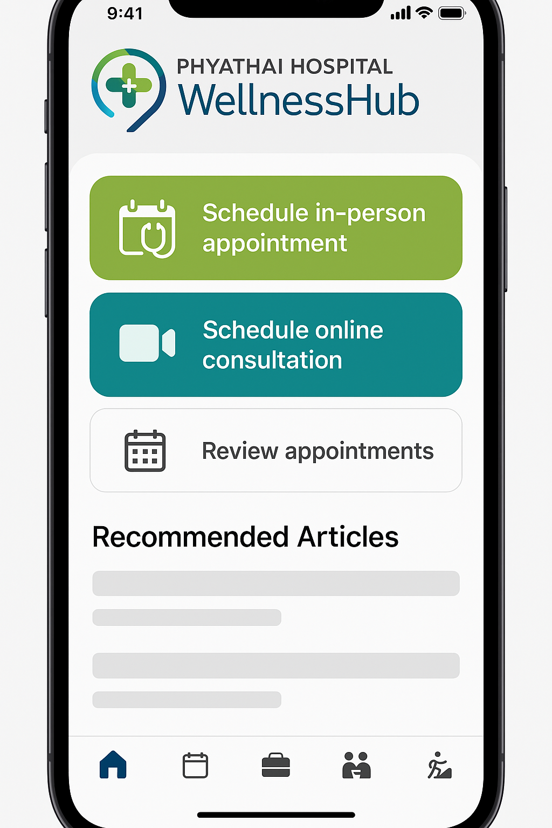




“WellnessHub” can leverage HealthUp’s existing application
The existing HealthUp application allows users to:
Book appointments
Notifications and reminders for upcoming appointments
Online consultations
Informative health articles
Key Features
Schedule and Attend Appointments
Bundle Wellness Activities
Online healthcare consultations are forecasted to grow at an 8.25% CAGR from 2023 – 2028
Family Health Management
Wellness Journey Recommendations
Sources: Abeam Consulting 2024

Slide 13
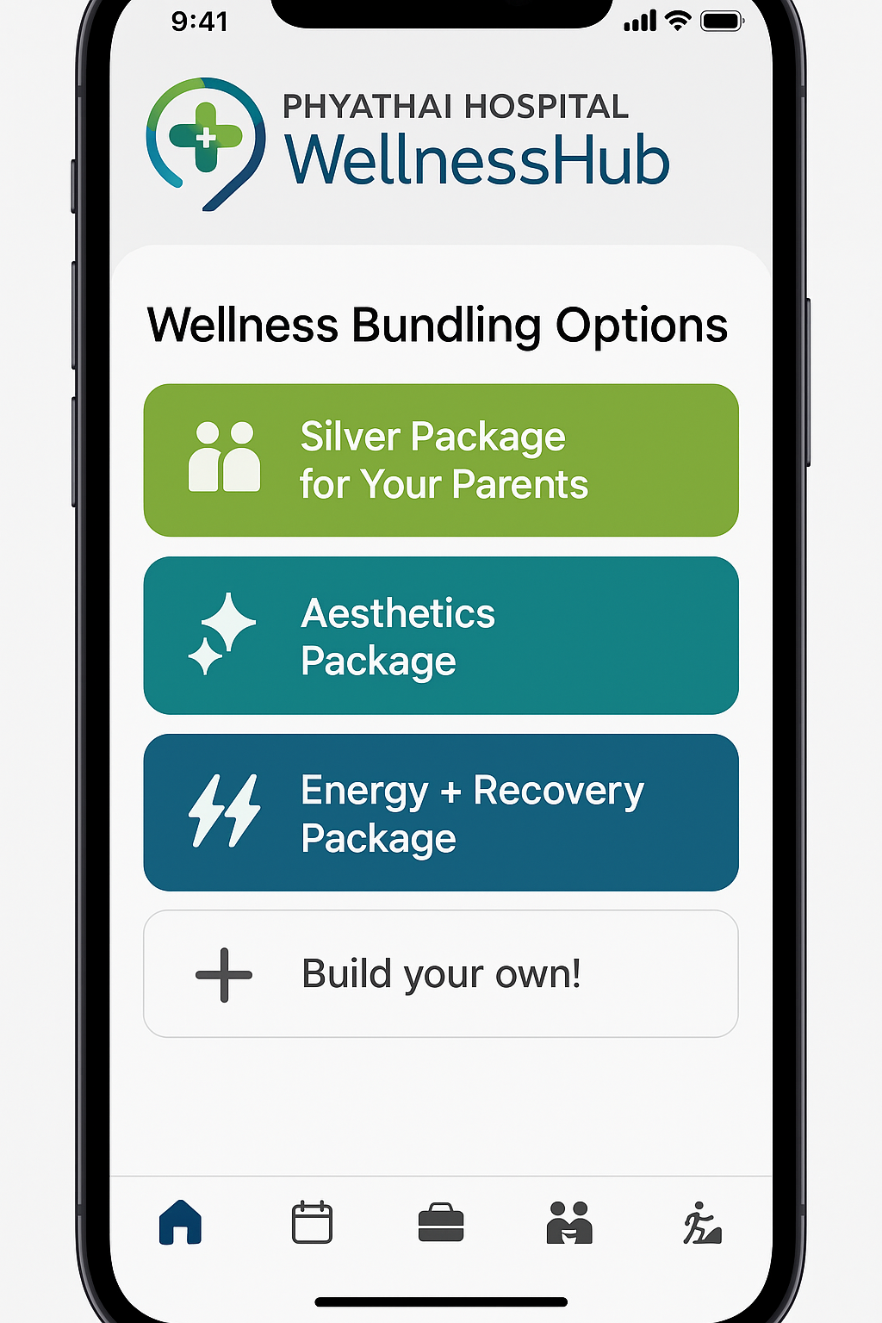
Bundling services can increase revenue for the target market
‘Lifestyle bundles’ users can build or choose pre-set packages based on their personal wellness goals:
Aesthetics (e.g. skin, anti-aging, laser)
Immunity (e.g. checkups, vaccines)
Family Care Package (wellness bundle for parents + kids - vaccines, dental, checkups)
Silver Package ("Care for Your Parents" plan for younger people to book for aging parents)
Key Features
Schedule and Attend Appointments
Bundle Wellness Activities
Family Health Management
Bundling can increase perceived value, simplify decision-making, and encourage higher spending
Wellness Journey Recommendations

Slide 14
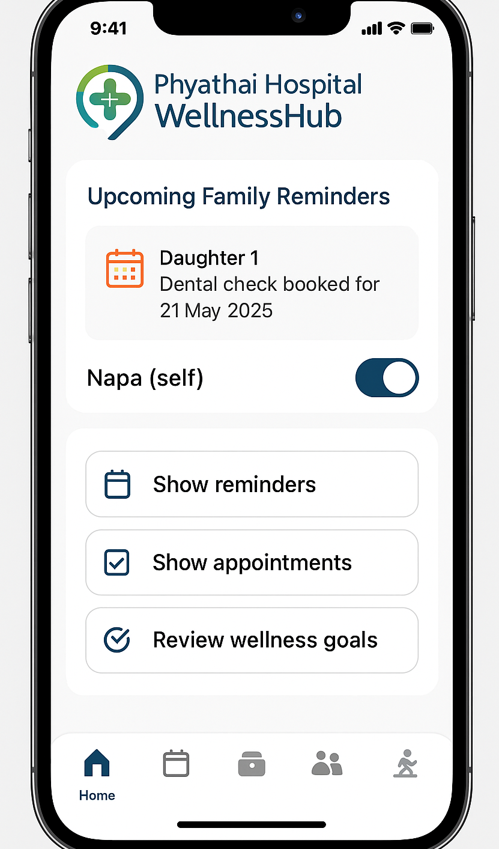
The target segment are time-poor and require efficiency
Key Features
Family Health Management could include:
Multi-family member dashboard
Shared bookings and reminders
Family health reports and milestones
Insights for each family member
Schedule and Attend Appointments
Bundle Wellness Activities
Thai customers are increasingly adopting digital health solutions for their convenience and accessibility.
Family Health Management
Wellness Journey Recommendations
Sources: EuroGroup Consulting 2024
Individuals in demanding careers, managing busy households, or navigating life as single parents are time-poor and require a solution that enables them to access preventive and wellness services

Slide 15
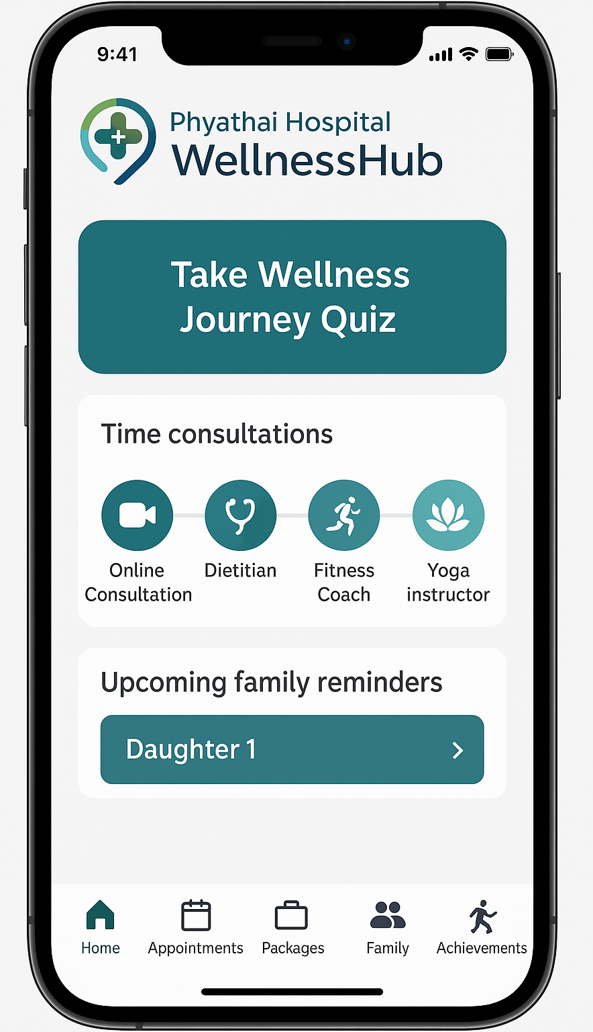
Personalised recommendations can up-sell further services
Wellness Journey Recommendations may leverage AI-driven insights and information acquired through API from the existing ‘AddWise’ application used in Phyathai hospitals.
Additionally, this section of the application may include a goal-based onboarding quiz, to align health data and customer interests, to create curated wellness journey recommendations.
Key Features
Schedule and Attend Appointments
Bundle Wellness Activities
Family Health Management
Wellness Journey Recommendations

Slide 16
A user can complete their wellness journey through one application
Meet Mayra
Young professional, single, social, image-conscious
Upper-middle income
“I want to look and feel confident, and easily follow health trends and organise my health and wellness activities”
Set up application
App prompts up-sell
Mayra & Napat can personalise the app by taking the goal-based quiz or adding family member information
Following first service, the application provides insights into next steps on Mayra & Napat’s wellness journeys
Meet Napat
Divorced, father of two kids
Middle income
“I hate waiting rooms and want myself and my children to have personalised, efficient, digital-first healthcare options”
Download App
Book service / bundle
Advocate
Napat/Mayra have consumed marketing materials directing them to download the WellnessHub app
Napat may book a family-oriented preventive health bundle, while Mayra books a single service, including online initial consultation
Mayra & Napat have revolutionised their health experience with the WellnessHub application, and recommend use to their friends and family

Slide 17
WellnessHub drives customer value while generating revenue
Value
1
Bundling Drives Recurring Revenue

Slide 18
WellnessHub drives customer value while generating revenue
Value
Value
1
2
Bundling Drives Recurring Revenue
Customers Engaging in Repeatable Care Cycles

Slide 19
WellnessHub drives customer value while generating revenue
Value
Value
Value
1
2
3
Bundling Drives Recurring Revenue
Customers Engaging in Repeatable Care Cycles
Provides Phyathai Hospitals a Branded Wellness Footprint

Slide 20

WellnessHub drives customer value while generating revenue
Value
Value
Value
Value
1
2
3
4
Bundling Drives Recurring Revenue
Customers Engaging in Repeatable Care Cycles
Provides Phyathai Hospitals a Branded Wellness Footprint
Maximises Existing Assets and Capabilities

Slide 21

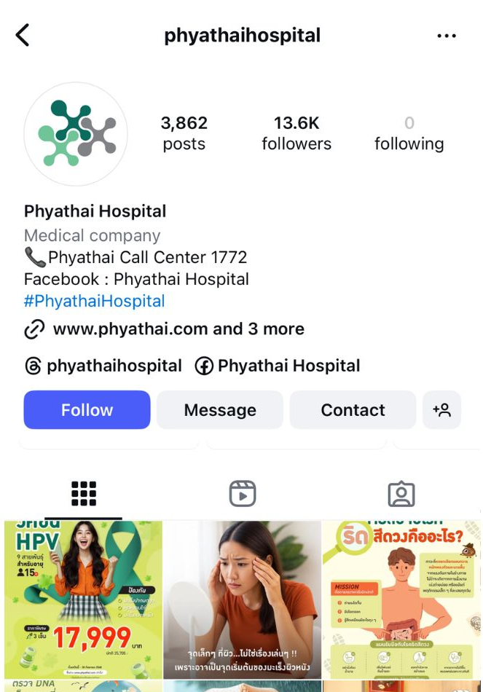
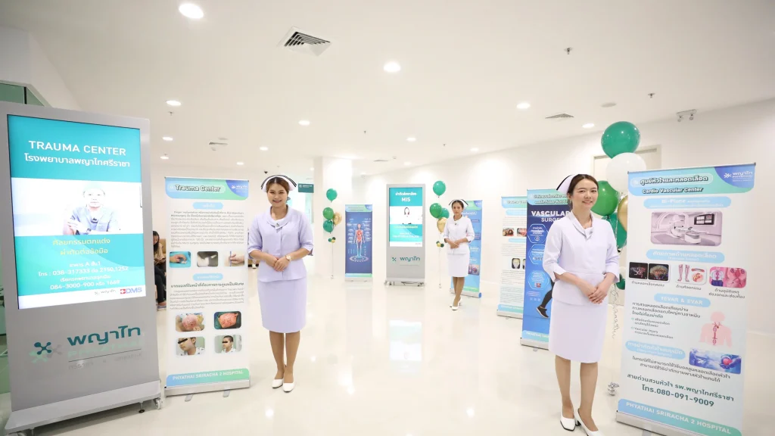

Multi-channel marketing can ensure target market reach
“Start Your 7-Day Wellness Reset”
Download HealthUp to unlock a free 7-day digital wellness plan tailored to your goals: energy, skin glow, immunity, stress relief, or family care!
LINE Ads + Official Account
QR Codes in Clinics & Wellness Spaces
Phyathai Hospital’s Social Media

Slide 22
WellnessHub can be promoted through key Thai marketing channels
“Start Your 7-Day Wellness Reset”
Key Messaging | Napat: “One App. Your Wellness, Your Schedule.” Mayra: “Feel Good. Look Great. All in One App.”
Channel | Why it Works
Line Ads | Line Thailand had 54 million users, accounting for 77% of mobile internet users. Supports chat automation, promotions, and rich content - great for education and conversion.
QR Codes Posters in Clinics & Wellness Spaces | Easy download triggers. Mayra & Napat are already engaging with Phyathai healthcare environments. Trusted Setting.
Phyathai Hospital Social Media | Phyathai’s official pages carry instant trust. Phyathai already has a large platform.
Retention
Push notifications, bundles, referral perks, in-app scheduling

Slide 23

”WellnessHub” launches in nine months, to ensure value in 3 years
Foundation & Planning
Build & Design
Pilot Launch & Feedback
June - August
September - November
December - March
2025
2025
2025 - 2026
Stakeholder Buy-In / Vision Alignment
User research & persona development
Mobilise human resources
Fully scope application and prioritise features for build
Technical analysis of product
UI/UX Design of the application confirmed
Marketing preparation
Content development
Technical development
Internal training & change management plan
Mobilise support teams
Soft-launch application
Monitor usage of the application and create feedback loops for improvement
Pilot marketing campaign
Prepare for scaling of application
Phase 1
Phase 2
Phase 3

Slide 24
Phyathai can achieve its goal of 30% wellness revenue growth through the implementation of WellnessHub

Slide 25
Wellness revenue is expected to beat 3-year topline growth targets
3-year Target Revenue
THB 3.05 B
(30.0% growth from 2024)
THB 4.88 B
THB 3.75 B
3-year Projected Revenue
THB 3.76 B
(40.45% growth from 2024)
THB 2.35 B
Repeat Customers
89.0%
As of 2023
The strategy leads to stronger topline performance, and coupled with Phyathai’s historically strong repeat customers, leads to sustainable long-term revenue.

Slide 26
The strategy’s sit well within the Phyathai’s marketing budget
Capital Deployment Timeline, 2025 to 2026
Marketing Costs, 2026 to 2028
2025 – THB 10 million
Phase 1:
Requirements gathering, scoping, UI/UX prototyping
Phase 2:
- Backend & API architecture setup, begin frontend dev
Frontend (bundling module), Admin portal setup
API integration, mid-term testing, compliance planning
Phase 3:
- QA testing, security hardening, consent/data logic
- UAT (User Acceptance Testing), staff onboarding, soft launch
2026 – THB 18 million
2027 – THB 15.5 million
2028 – THB 11.5 million
Our projections consider the complete use of the THB 60 million marketing budget as a sensitised, worst-case cost scenario.
2026 – THB 5 million
AI capacity, API and server scaling

Slide 27
The forecast have been sensitised and are therefore robust
Key Methods and Assumptions
Top-down forecasting from BDMS financial statements
The model emphasises macro trends and market dynamics to arrive at Phythai and Wellness revenue.
Conservative cost structure
Expenditure has been set high relative to historical figures.
Forecast has been sensitised to margin contraction for macro uncertainty
Incorporation of weaker gross, operating and net margins to cast a safety net.
Valuation metrics based on publicly available information for BDMS
Our inputs are highly scrutinised and sourced from reputable analyst firms, allowing transparency.
With a wide-spanning safety net, Phyathai can have confidence in our figures.

Slide 28
The projections show strong project value and feasibility
Project Value
Feasibility
Increase in NPV over 3 years
THB 212 million
Compared to estimated firm value based on historical growth.
Proposed feasibility
High
Based on conservative cost and margin estimates
Our conservative approach also lends support to the additional value created and the feasibility.

Slide 29
Executive Summary
BUT THERES A GAP
Wellness Market Boom
Digital-First Demand
Underused Service Potential
Thailand’s wellness market grew 28.4% year-on-year in 2023
Consumers expect digital, personalised wellness, and many already use apps to manage their health.
Phyathai’s wellness services are strong, but not packaged or promoted in a way that drives long-term use.
Insights
Wellness services are strong, but not packaged in a way that encourages long-term use.
Key consumer segments aren’t being actively targeted or engaged.
Digital tools like HealthUp are not being fully used to grow the wellness offering.
Issues
How can Phyathai grow its preventive and wellness services by 30% and become the top of mind health and wellness destination for the mid-high income segment in 3 years?
Question
Repackage Phyathai’s current wellness services into lifestyle-based bundles, delivered through an updated WellnessHub, built from the existing HealthUp app.
Strategy
Offers modular wellness bundles tailored to lifestyle goals
Builds a digital hub for seamless personalised care
Activates targeted campaigns to boost engagement and loyalty
THB 212m
Increase in
3-year NPV
THB 4.45b
3-year Projected Revenue
+17.52%
Net Profit Margin
(2026-2028)
Impact

Slide 30
Customer Segments
Napat, the Self-Reliant Multitasker
Self-Reliant & Individualistic
Mayra, Radiance Seeker
Living Life & Looking Good Segment
“Health is important, but it needs to fit into my life, not disrupt it.”
“I invest in myself - looking and feeling my best is non-negotiable”
Needs & Pain Points: No time for long hospital visits or unclear bookings. Wants control over her own and her children’s care. Looks for trusted yet convenient services
Needs & Pain Points:
Wants visible results from services she trustsSeeks curated experiences with lifestyle credibilityPrefers apps that look and feel premiumLoves sharing her routines on social media
What she values: Smart scheduling, same-day appointments
Bundled family packages she can manage in one app
Clear, upfront pricing and digital receipts
Customisable plans she can adjust without calling anyone
Preventive care that enhances appearance and longevityAesthetic services bundled together (e.g. skin, dental, anti-aging)Health content that matches her interestsSocial reward systems and exclusive perks

Slide 31
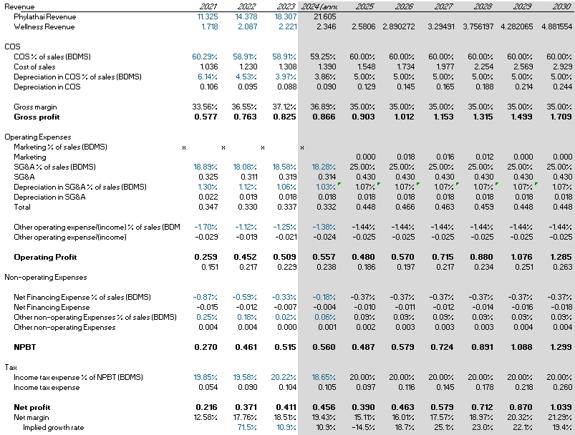
Finance – Income Statement Projections

Slide 32
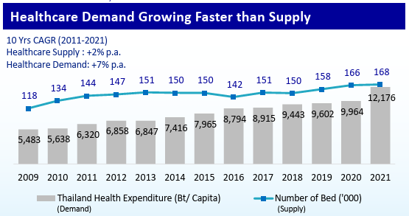
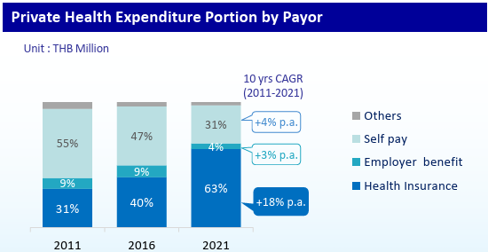
Finance – Revenue Drivers
Industry-Level Growth Benchmarks
Thai Private Hospital Market
CAGR of ~8% (2022–2024), according to TTB Economic Analysis Center.
Phyathai wellness revenue from THB 1.7B (2021) to 2.2B (2023) -> ~14.5% CAGR, per case data.
Global Wellness Market
Global wellness economy valued at $4.4 trillion in 2020 and forecast to reach $7 trillion by 2025, growing at ~9% CAGR (Global Wellness Institute).
In Thailand, the wellness tourism market alone was worth THB 400B as of 2017 and continues expanding.
Segment-Level Demand Growth
Anti-Aging Services
Fastest-growing segment in Phyathai’s portfolio.
29% CAGR from 2021–2023 per case data -> strong tailwind.
Skin & Laser, Dental
Skin & Laser: 16% CAGR (2021–2023)
Dental: 10% CAGR (2021–2023)
Digital & Product Expansion Multiplier
Your model incorporates app upgrades and new bundling functionality. These enable:
Higher service utilization per user (cross-selling wellness services)
Improved retention and repeat visits via personalized care journeys
New customer acquisition channels (HealthUp app + digital marketing)

Slide 33
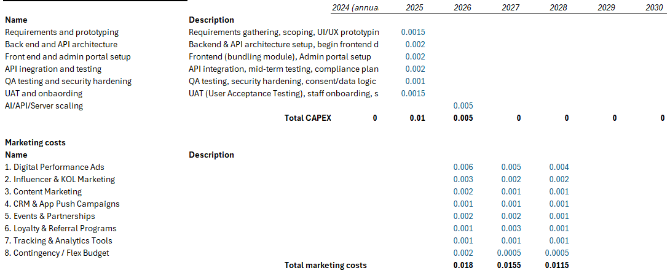
Finance - Budget:Marketing and CAPEX

Slide 35
Why didn’t we choose other solutions?
Solution | Why we did not choose it
Omnichannel marketing Campaing | Digital campaigns are easy for competitors to replicate; may not differentiate Phyathai enough in a crowded market. Doing this solution by itself would not be sufficient as a solution
Wearable Wellness Tracker | High upfront investment in tech infrastructure, training, and data privacy compliance. High degree of competition that have had entry into the market for a long time, with expertise in the range.
Flagship Wellness Center | Could cannibalise existing income from other BDMS brands. Real estate, construction, and staffing costs are high, with a long return on investment horizon.
Corporate Expansion | Relies on companies' willingness to invest in employee wellness, which can fluctuate with economic conditions. Existing position with corporate clients, may cannibalise sales and not likely to expand revenue as much as anticipated

Slide 36
How would we measure success for this product?
Adoption: % of HealthUp users who onboard to Wellness Hub
Engagement: Repeat bundle purchases, average monthly bookings, completion of wellness journeys
Revenue: Wellness bundle revenue vs. historical baseline, cross-sell uplift from PowerHour or family care add-ons
Perception Shift: Brand perception survey (clinical provider → wellness partner)

